Slide 1


MODELO CUSTOM SHOP
FY24 PROGRAM RECAP
© MOMENTUM WORLDWIDE 2023 IN CONFIDENCE. THIS DOCUMENT MAY NOT BE DISTRIBUTED OR COPIED WITHOUT PRIOR CONSENT.

Slide 2
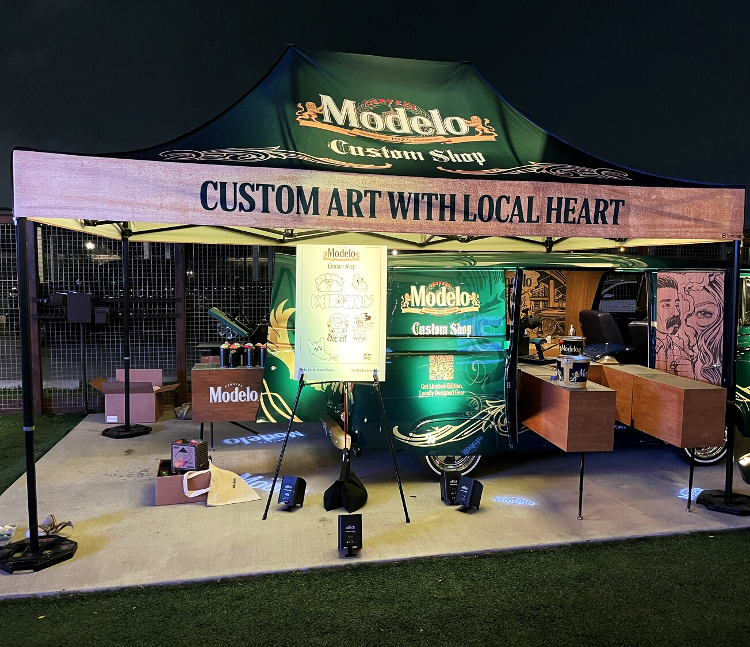
TABLE OF CONTENTS
PROGRAM OVERVIEW MARKET IMPACT ARTIST + SOCIAL IMPACT PHOTOS & CONSUMERS ACCOUNT FEEDBACK KEY LEARNINGS ACCOUNT APPENDIX | 3 - 9 10 - 16 17 - 30 31 - 33 34 - 36 37 - 40 42 - 67

Slide 3
PROGRAM OVERVIEW
© MOMENTUM WORLDWIDE 2023 IN CONFIDENCE. THIS DOCUMENT MAY NOT BE DISTRIBUTED OR COPIED WITHOUT PRIOR CONSENT.

Slide 4
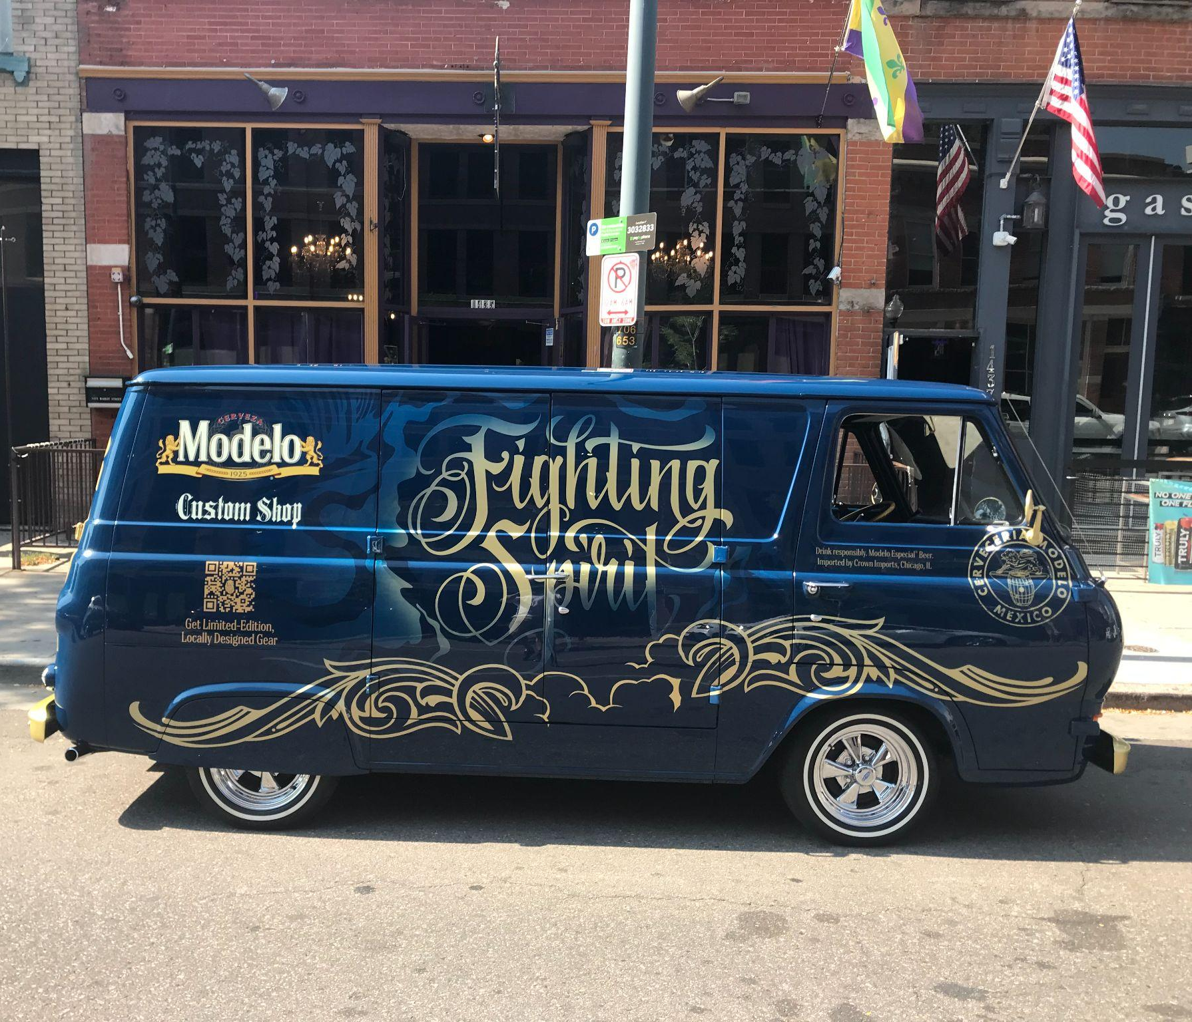
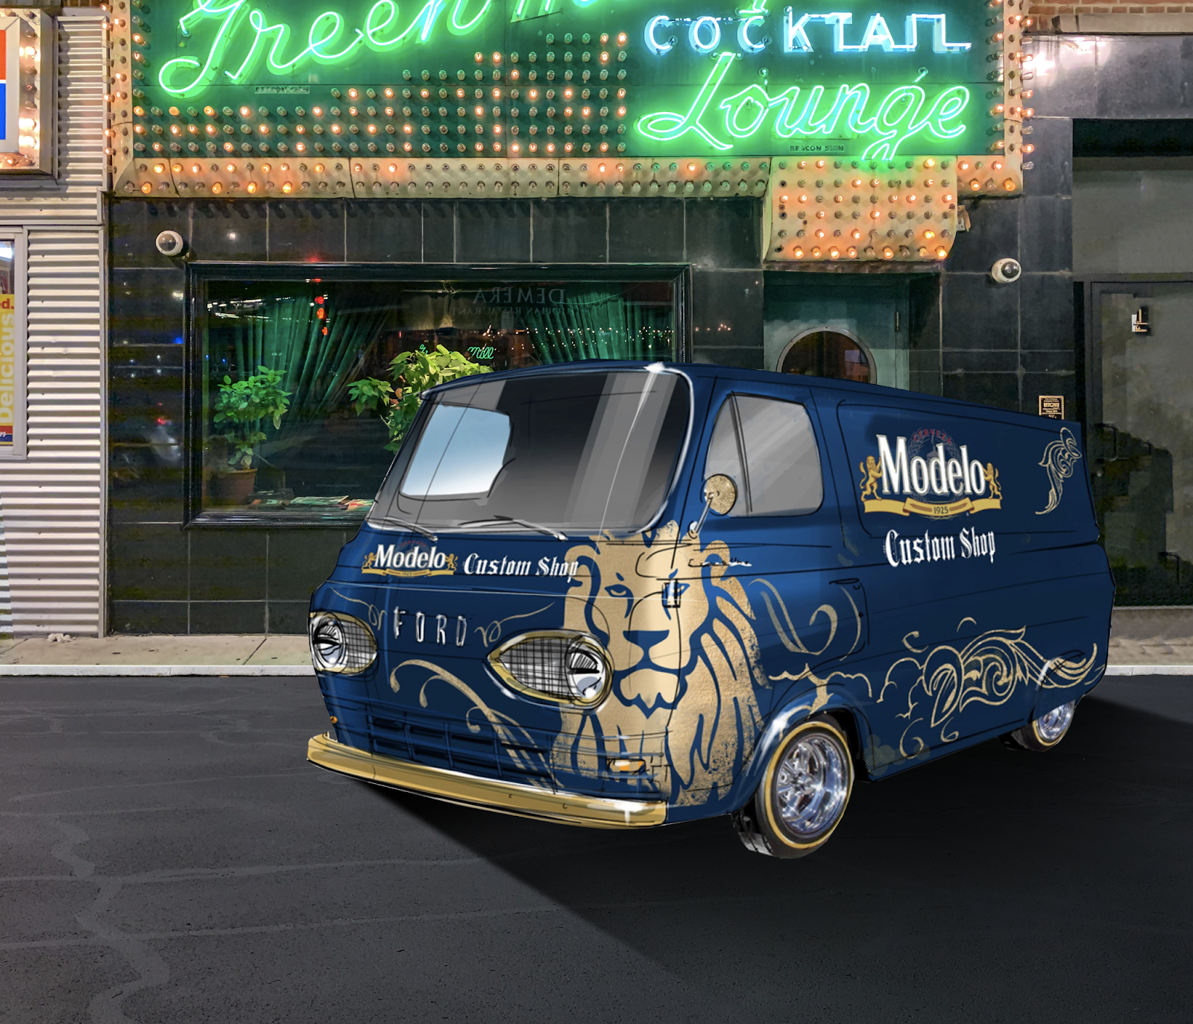

CONCEPT
The Modelo Custom Shop
One of the truest marks of an artist is that they don’t own everyday items—because they always put their own unique spin on them.
So, we rolled around the country with our Modelo Custom Shop, working with local artists to customize limited-edition gear LIVE on-site.
Our shops scaled from MBN’s to an elevated experience, complete with a custom
Modelo vehicle.
© MOMENTUM WORLDWIDE 2023 IN CONFIDENCE. THIS DOCUMENT MAY NOT BE DISTRIBUTED OR COPIED WITHOUT PRIOR CONSENT.

Slide 5
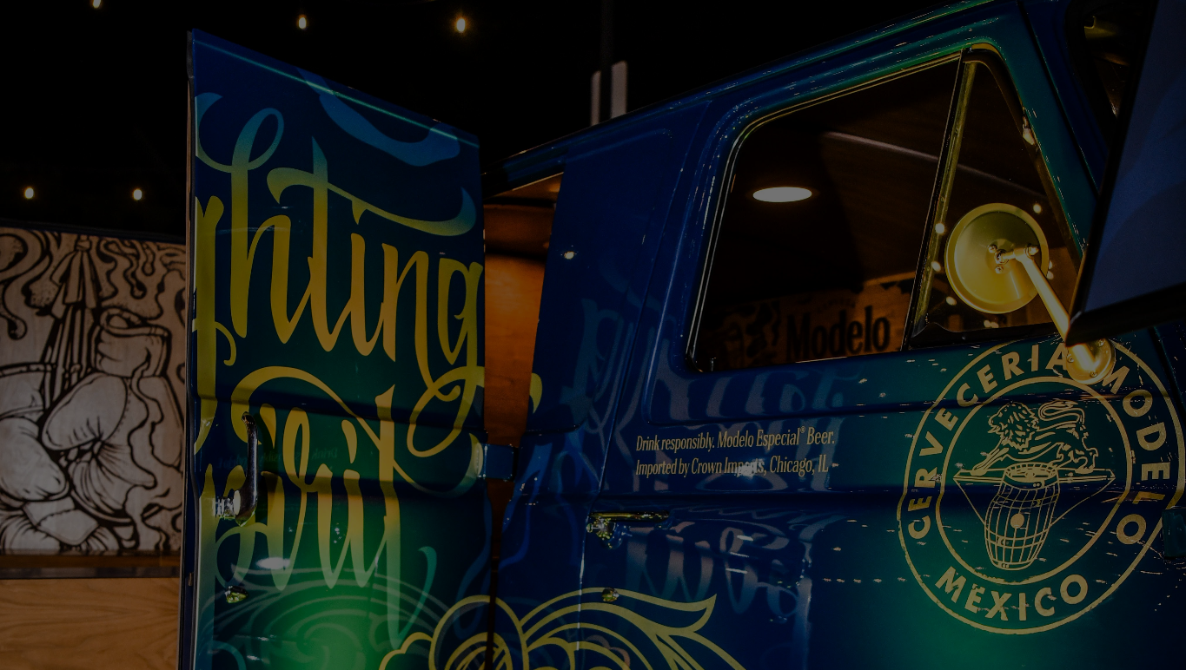
MODELO CUSTOM SHOP
PROGRAM EVOLUTION
In Year 3, we elevated the Custom Shop to a platform that energized the Fighting Spirit of Artistry and rewarded consumers with unique access to their community.
Enhanced the consumer engagement at activation with block printing application, Spanish POS, and elevated the giveaways.
Expanded the tour by developing 3 additional Custom Shop Vans, adding 3 new markets and one new van tour.
Increased artist visibility by developing market specific tap handles that deepen the connection with the community.
Amplified the microsite consumer engagement by enhancing the sweepstakes prize to an e-scooter.
© MOMENTUM WORLDWIDE 2023 IN CONFIDENCE. THIS DOCUMENT MAY NOT BE DISTRIBUTED OR COPIED WITHOUT PRIOR CONSENT.

Slide 6
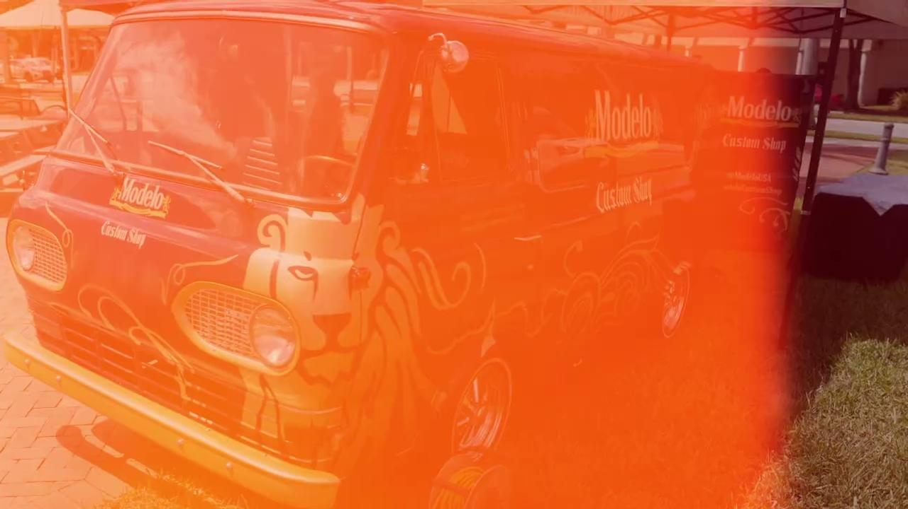
MODELO CUSTOM SHOP
SIZZLE REEL

Slide 7
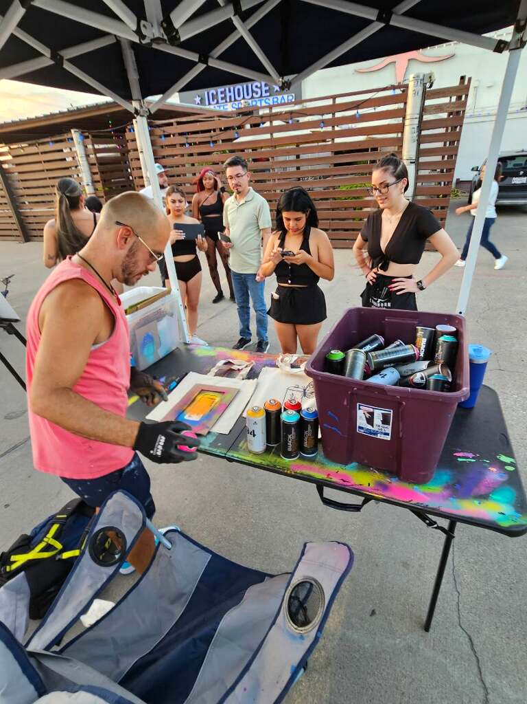
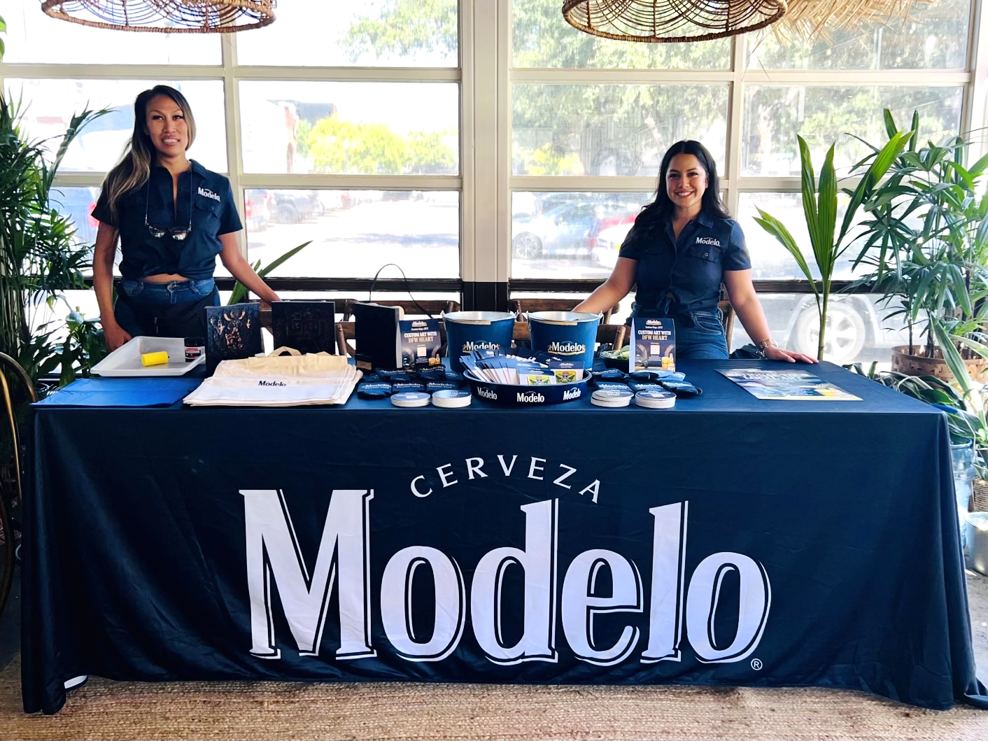
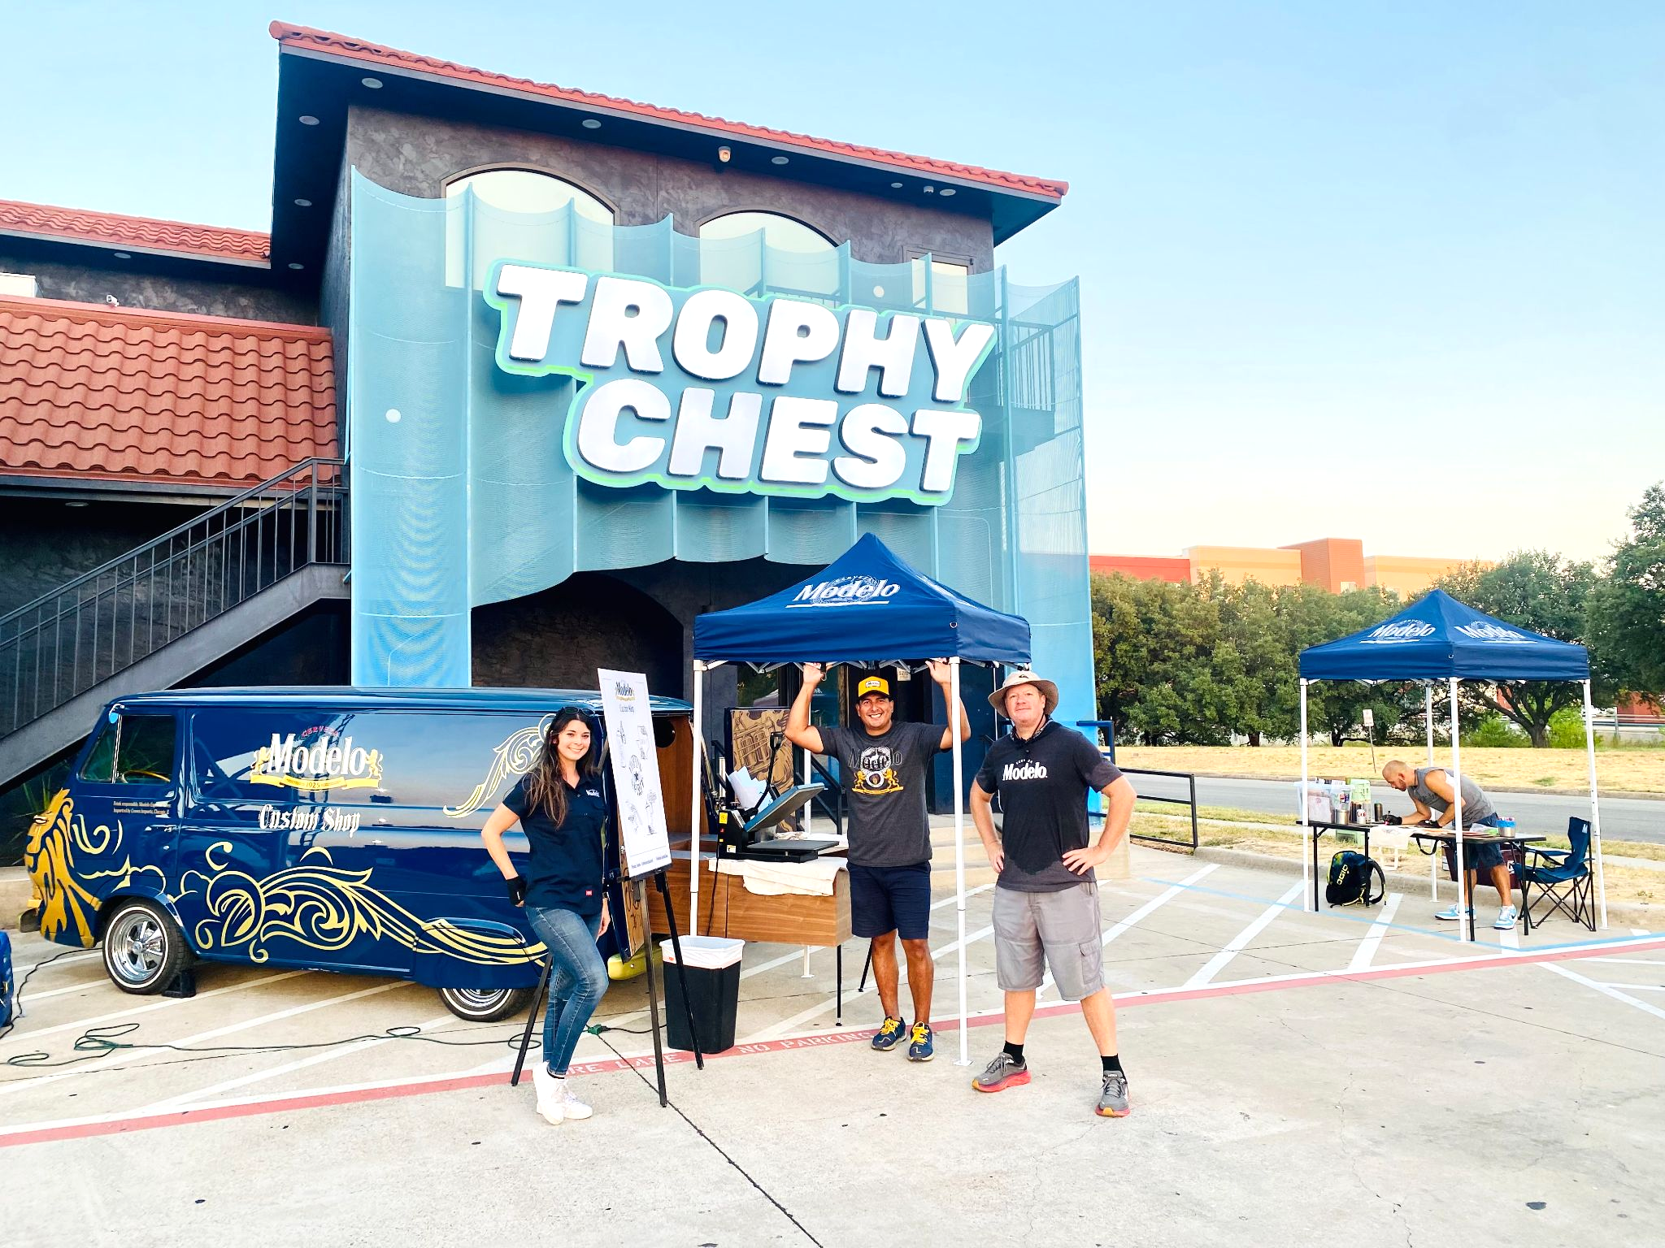
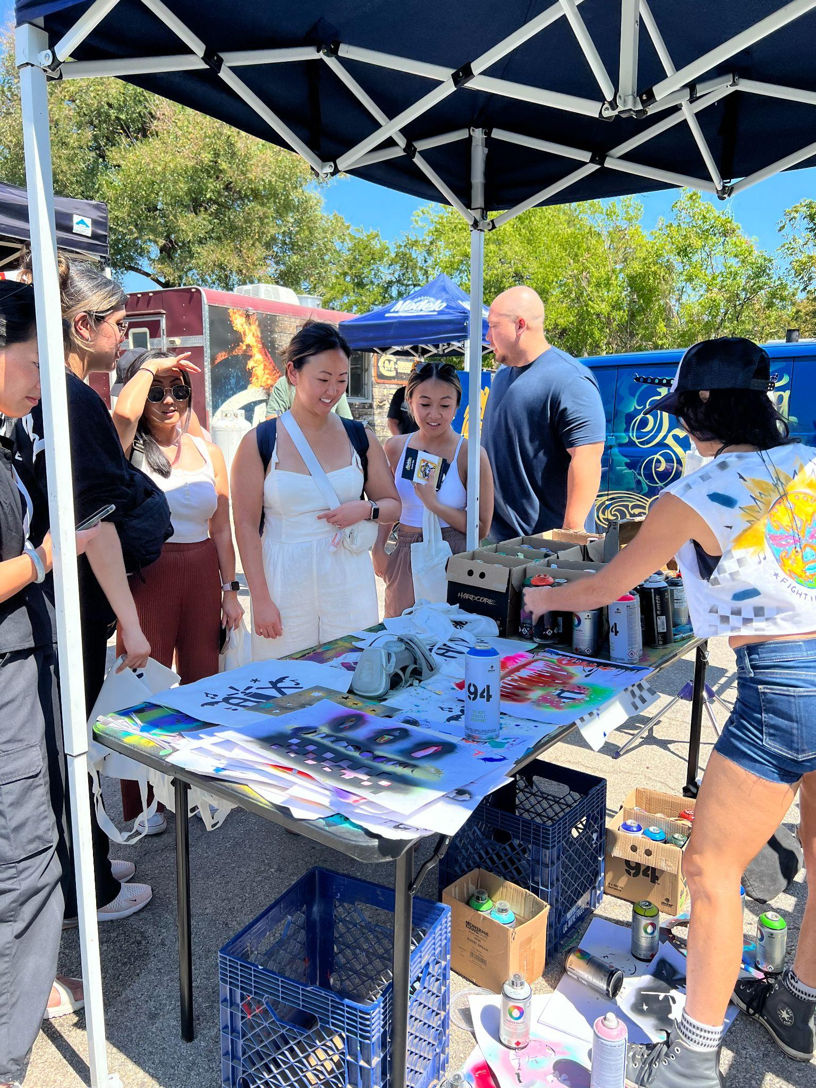
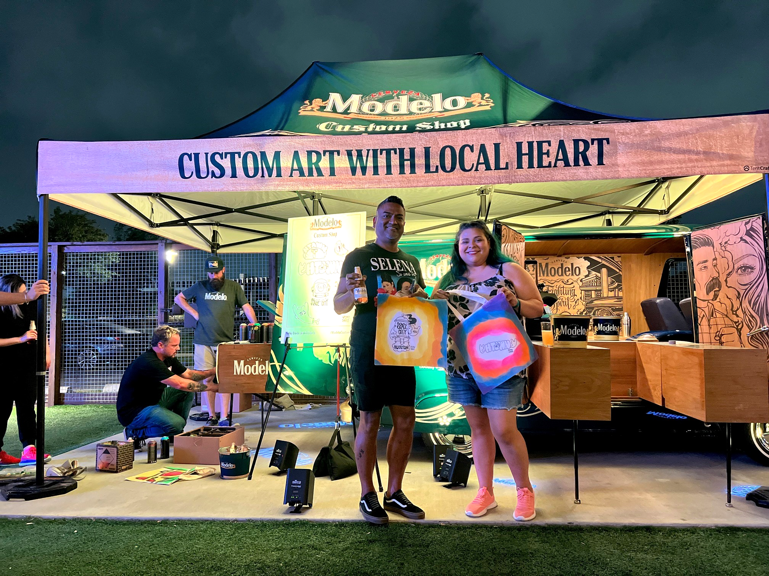
MODELO CUSTOM SHOP
STREET TEAM
91 BRAND AMBASSADORS:
Vital extension of the sales team
Brought Modelo to life, adding brand visibility
Made authentic, lasting impressions on consumers
22 LOCAL ARTISTS:
Brought unique creativity to engagements
Provided consumers with one-of-a-kind pieces
Connected with consumers on a hyper-local level, showcasing brand authenticity
6 TOUR MANAGERS:
Integral part of the brand
Showcased the custom van as a photo opp and key talking point
Ensured consumer experience at the van setup was optimized to its fullest potential.

Slide 8
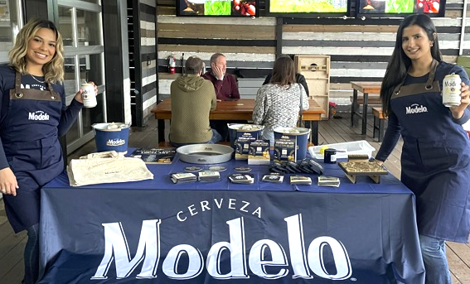
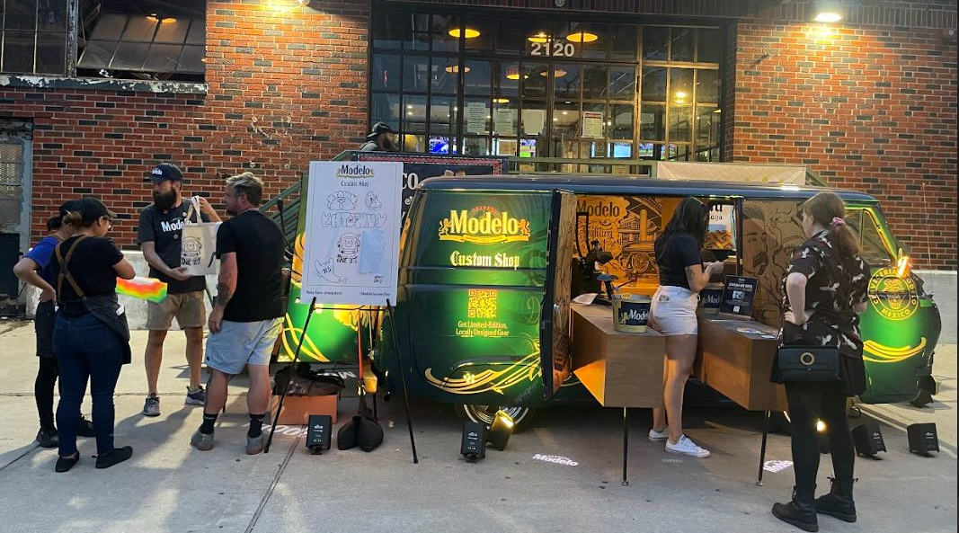
MODELO CUSTOM SHOP
ACTIVATIONS
BA led activations (No van or artist):
Sampling & brand education
BA led activations featuring customized block printing giveaways.
Hyper-local city callouts for personalized engagement.
Upgraded giveaways: totes, shirts, hats for enhanced experience.
Spanish POS, custom tap handles, and a custom e-scooter sweepstakes.
Elevated activations with the (van + artist):
Sampling & brand education
Local artist on-site customizing one-of-a-kind giveaways.
Custom Modelo van as a billboard and photo opp for consumers.
Fully displayed van for walk-ups and branded giveaways.

Slide 9
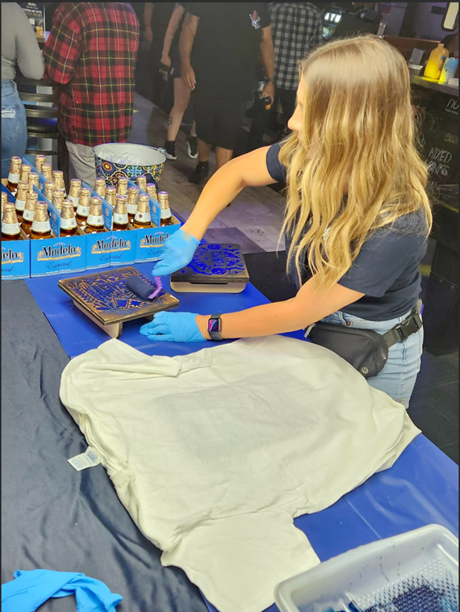
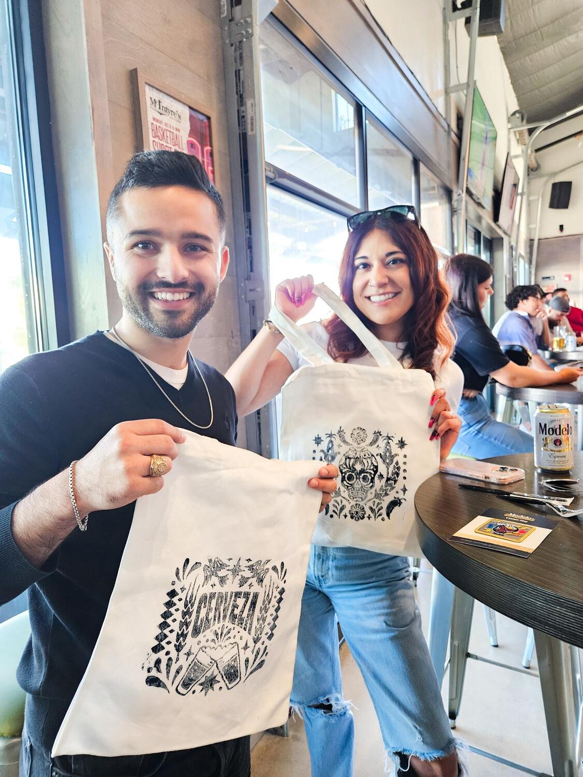
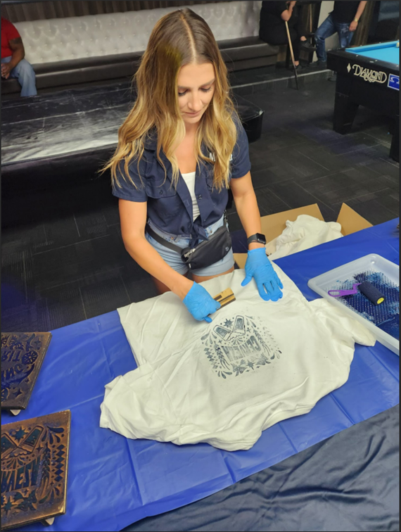
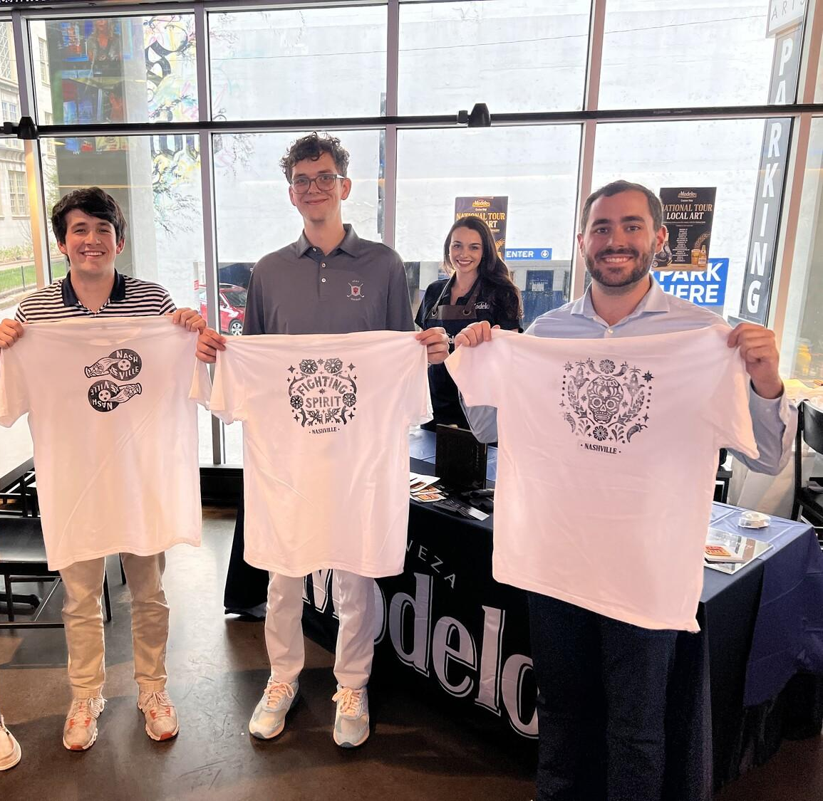






MODELO CUSTOM SHOP
BLOCK PRINT
Modelo partnered with Rodolfo Baquier to create three national Modelo block prints.
The block print designs focused on the brand story of the “Fighting Spirit”, location/birth heritage story, Mexican culture/history “Sugar Skulls” and product story “Cerveza”. One additional block featured the city name.
Block prints were applied to t-shirts and premium totes.

Slide 10
MARKET IMPACT
© MOMENTUM WORLDWIDE 2023 IN CONFIDENCE. THIS DOCUMENT MAY NOT BE DISTRIBUTED OR COPIED WITHOUT PRIOR CONSENT.

Slide 11
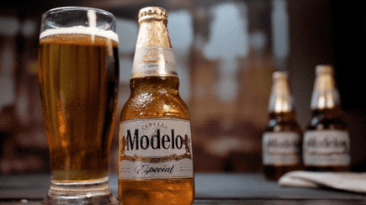
MODELO CUSTOM SHOP YEAR 3 SNAPSHOT - APRIL 7TH THROUGH OCT 22ND
MARKETS
18
ACCOUNTS
419
EVENTS
658
BAR SPEND
$226,697
IMPRESSIONS
71,888
ENGAGEMENTS
55,364
SAMPLED
37,054
GIVEAWAYS
58,981
*Programming achieved 93% of sampling goal in majority of markets; remaining markets not hitting goal experienced draft inventory issues, slower foot traffic and inclement weather
**313 number of Van/Artist event and 345 number of MBNs executed
© MOMENTUM WORLDWIDE 2023 IN CONFIDENCE. THIS DOCUMENT MAY NOT BE DISTRIBUTED OR COPIED WITHOUT PRIOR CONSENT.

Slide 12
MODELO CUSTOM SHOP PROGRAM TIMELINE
 | APRIL | MAY | JUNE | JULY | AUGUST | SEPTEMBER | OCTOBER
HOUSTON
PHOENIX
SAN DIEGO
LOS ANGELES
SAN FRANCISCO
DC/NOVA
BOSTON
PHILADELPHIA
NEW YORK
CHARLOTTE
MIAMI
NASHVILLE
CHICAGO
MICHIGAN
DENVER
DALLAS
AUSTIN
SAN ANTONIO
TOUR 1
TOUR 2
TOUR 3
© MOMENTUM WORLDWIDE 2023 IN CONFIDENCE. THIS DOCUMENT MAY NOT BE DISTRIBUTED OR COPIED WITHOUT PRIOR CONSENT.

Slide 13
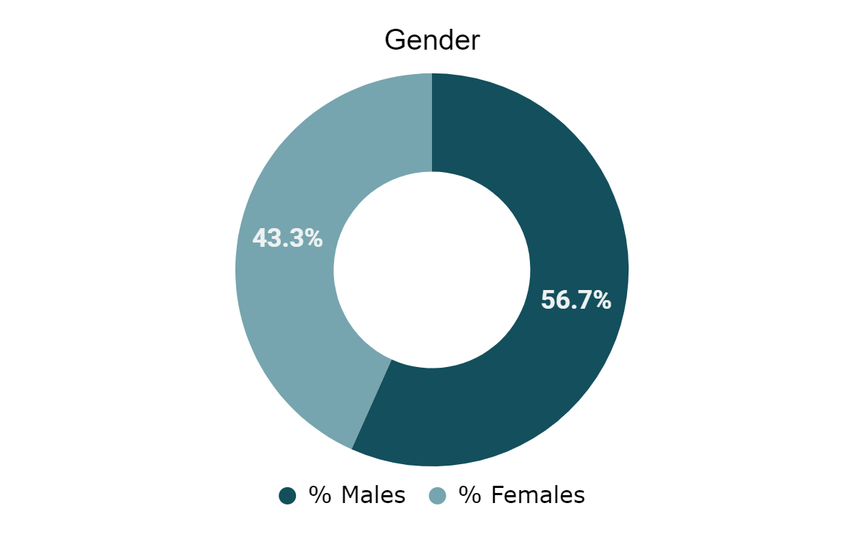
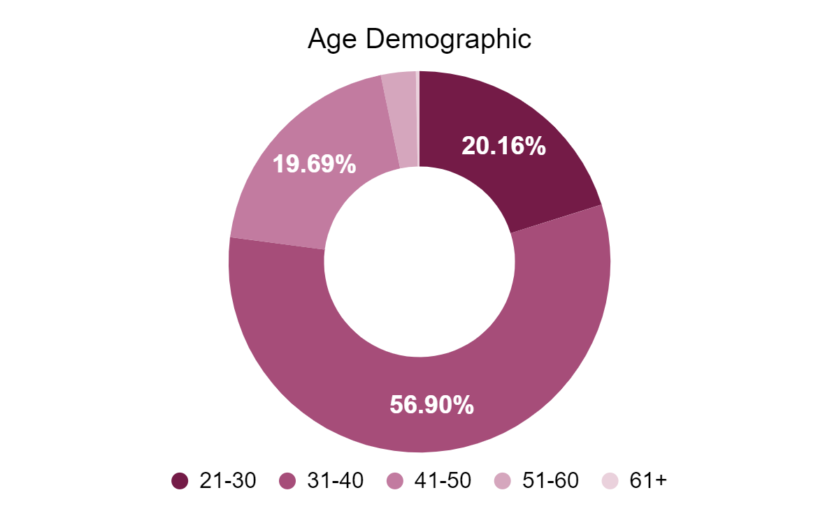
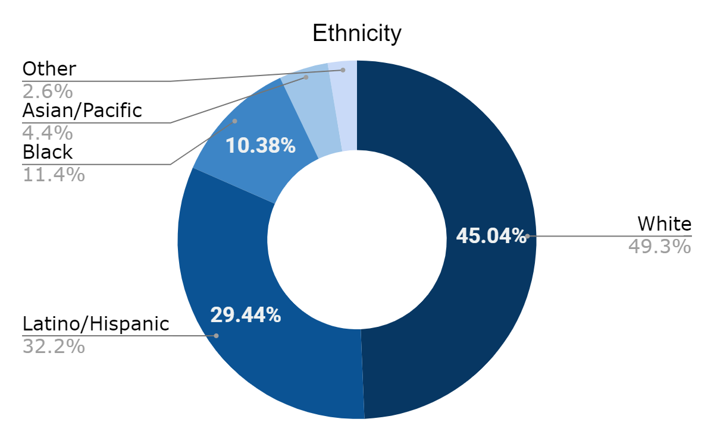
MODELO CUSTOM SHOP CONSUMER DEMOGRAPHICS
In FY’24, programming reached a majority of White and Hispanic males aged 31-40 years of age. Opportunity to expand within the female demographics, as well as increase reach for other ethnicities.
To adjust the chart style, right-click or control-click on the chart and select “Format Chart Area”

Slide 14
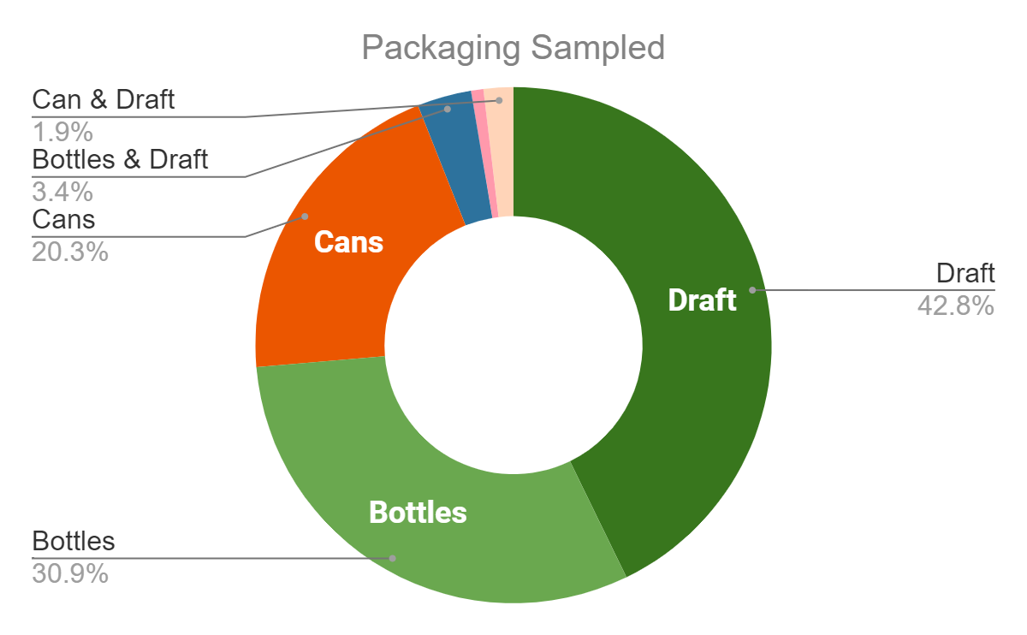
MODELO CUSTOM SHOP PACKAGING BREAKDOWN
More than half of accounts sampled a mix of bottles and/or cans. Despite draft challenges, nearly half of consumers sampled draft. Opportunity to continue increasing draft percentages for FY’25.
To adjust the chart style, right-click or control-click on the chart and select “Format Chart Area”

Slide 15
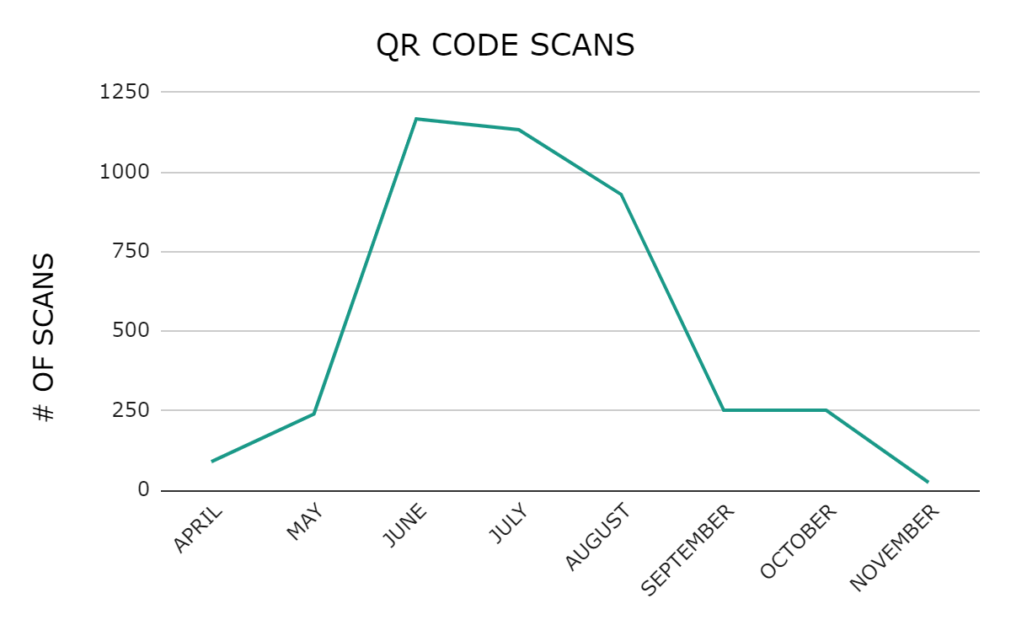
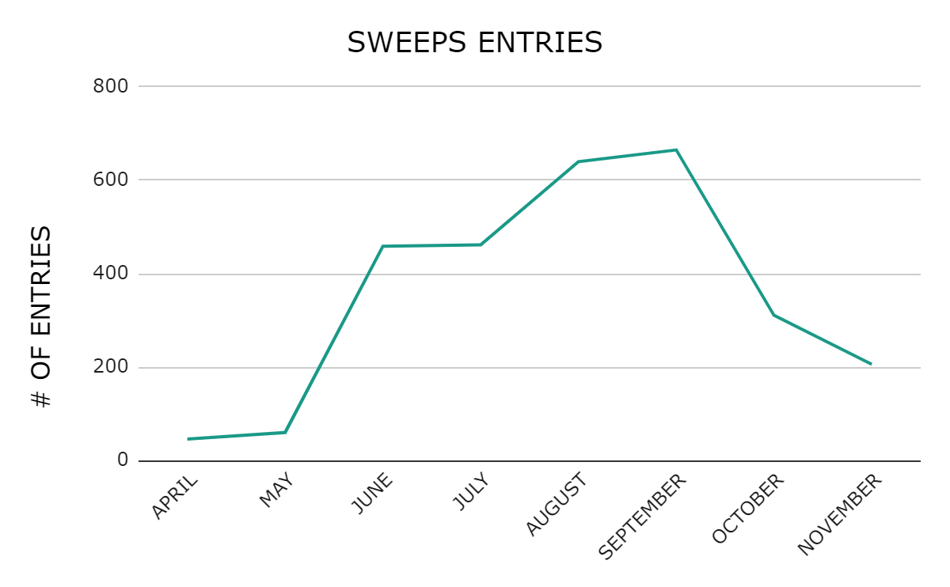
MODELO CUSTOM SHOP MICROSITE ENGAGEMENT
Microsite engagements across 18 markets from April 7th, 2023 - December 1st, 2023. We saw a 73% YOY increase in microsite traffic and sweeps entries due to elevated prizing of a Phat Scooter that drove consumer excitement. Highest sweeps engagement from June-August when all three vans were activating simultaneously.
ENGAGEMENTS
5,623
PAGE VIEWS
23,452
AVG. ENGAGEMENT TIME
58 SEC
*The total number of active users.
*The number of app screens or web pages your users saw.
ARTIST PAGE VIEWS
402
SWEEPS ENTRIES
2,849
QR CODE SCANS
4,909
To adjust the chart style, right-click or control-click on the chart and select “Format Chart Area”

Slide 16
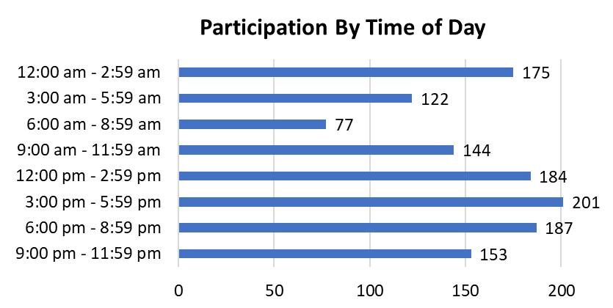
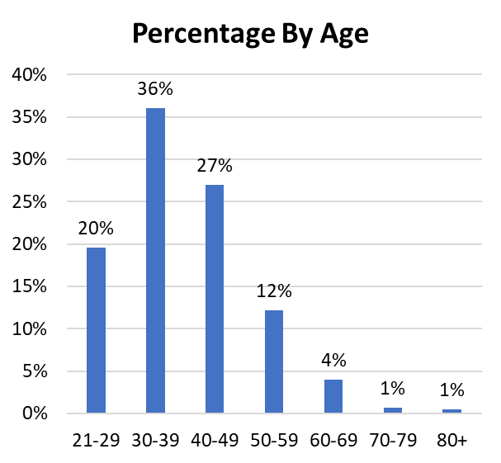
MODELO CUSTOM SHOP SWEEPS ENTRIES INSIGHTS
Entry Count By State
AZ | 112
CA | 293
CO | 216
DC | 18
FL | 93
IL | 355
MA | 16
MI | 114
NC | 269
NY | 493
PA | 272
TN | 21
TX | 511
VA | 66
Texas had the highest sweeps entries
Increased sweeps entry trend between 3pm- 6pm
Most participants were between 30-39 years old
Sweeps Winners:
WBU Winner: Pacoima, CA
CBU: Broomfield, CO
EBU: Medfield, MA
SEBU: Charlotte, NC
SBU: Austin, TX
To adjust the chart style, right-click or control-click on the chart and select “Format Chart Area”

Slide 17
ARTIST PARTNERSHIP + SOCIAL RESULTS
© MOMENTUM WORLDWIDE 2023 IN CONFIDENCE. THIS DOCUMENT MAY NOT BE DISTRIBUTED OR COPIED WITHOUT PRIOR CONSENT.

Slide 18
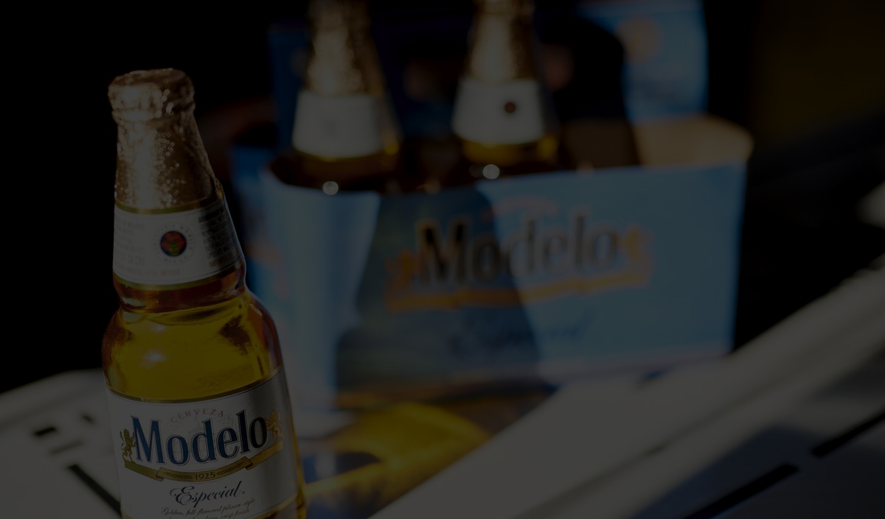
MODELO CUSTOM SHOP
THE GOAL
2023’s Modelo Custom Shop brought the Modelo fighting spirit to major communities across the country.
We collaborated with 22 hyper-local artists to design customized gear representing their hometowns and leveraged their neighborhood followings and credible reputations to amplify the program via social channels.
© MOMENTUM WORLDWIDE 2024 IN CONFIDENCE. THIS DOCUMENT MAY NOT BE DISTRIBUTED OR COPIED WITHOUT PRIOR CONSENT.

Slide 19
MODELO CUSTOM SHOP TOPLINE RESULTS
2023’s program content was well-received, resonating with a small audience–as indicated by the high engagement rate–however, there’s opportunity to improve amplification tactics and overall awareness in 2024.
147 .
EARNED MENTIONS The total amount of ‘Modelo Custom Shop’ mentions across Instagram, Facebook, Twitter and TikTok.
$5.2K .
EARNED MEDIA VALUE* The total worth of the engagements our content yielded across talent channels.
99% .
NET POSITIVE SENTIMENT The difference between total positive and negative event mentions. . +7 vs. 2023 Modelo sentiment
107.4K .
IMPRESSIONS* The number of times our branded content was seen between talent and any owned posts
-90% vs. Avg. Beverage Industry Instagram Impressions
7,980 .
ENGAGEMENTS* The total amount of likes, comments and shares on our content.
7.4% .
ENGAGEMENT RATE* Total engagements divided by total impressions.
+6.5% vs. Avg. Beverage Industry Instagram Engagement Rate
*Talent performance data is incomplete due to unavailable Instagram Story and select infeed metrics.
Sources: Social Listening Tool, 2024 Social Media Industry Benchmarks 2023, Social Insider, 2024
Social Media Benchmarks: Q4 2023, Hootsuite, 2024
To adjust the chart style, right-click or control-click on the chart and select “Format Chart Area”

Slide 20
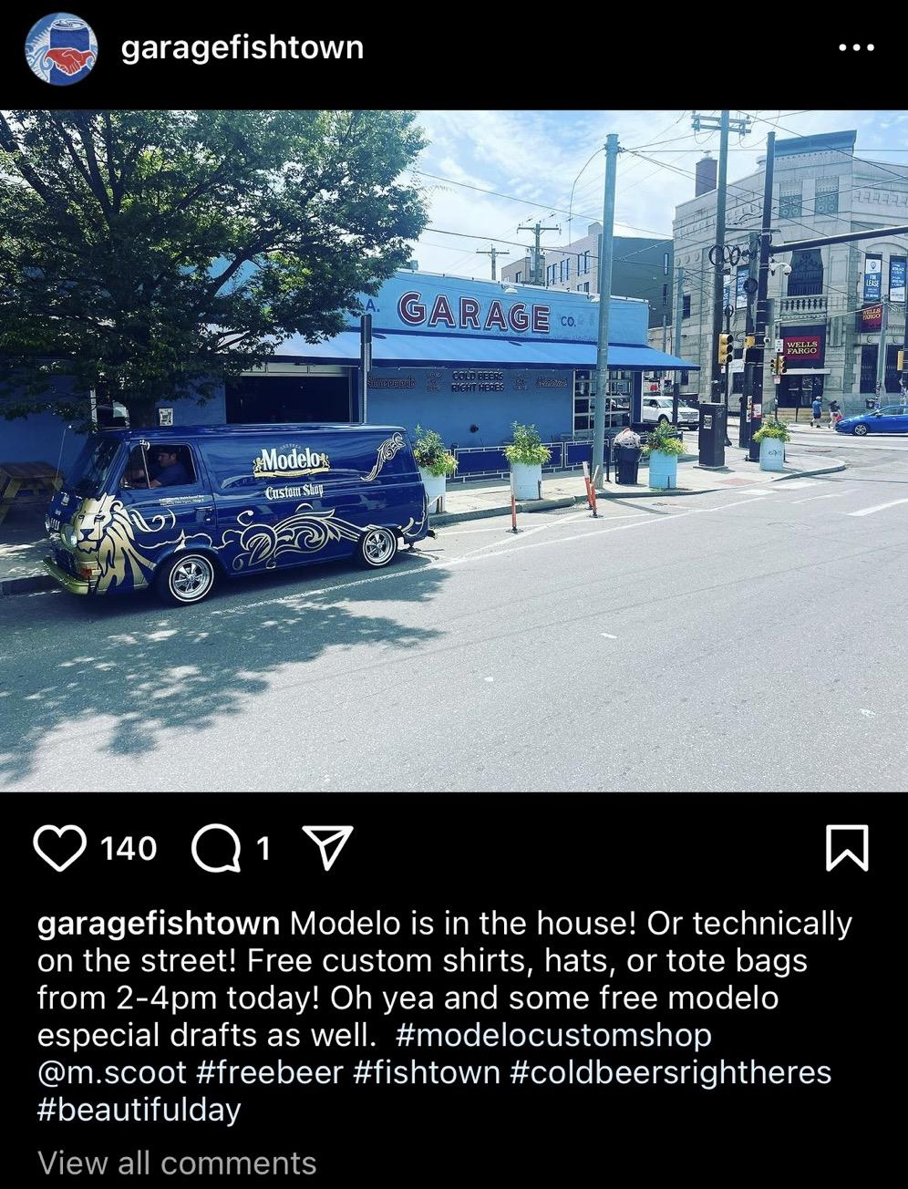
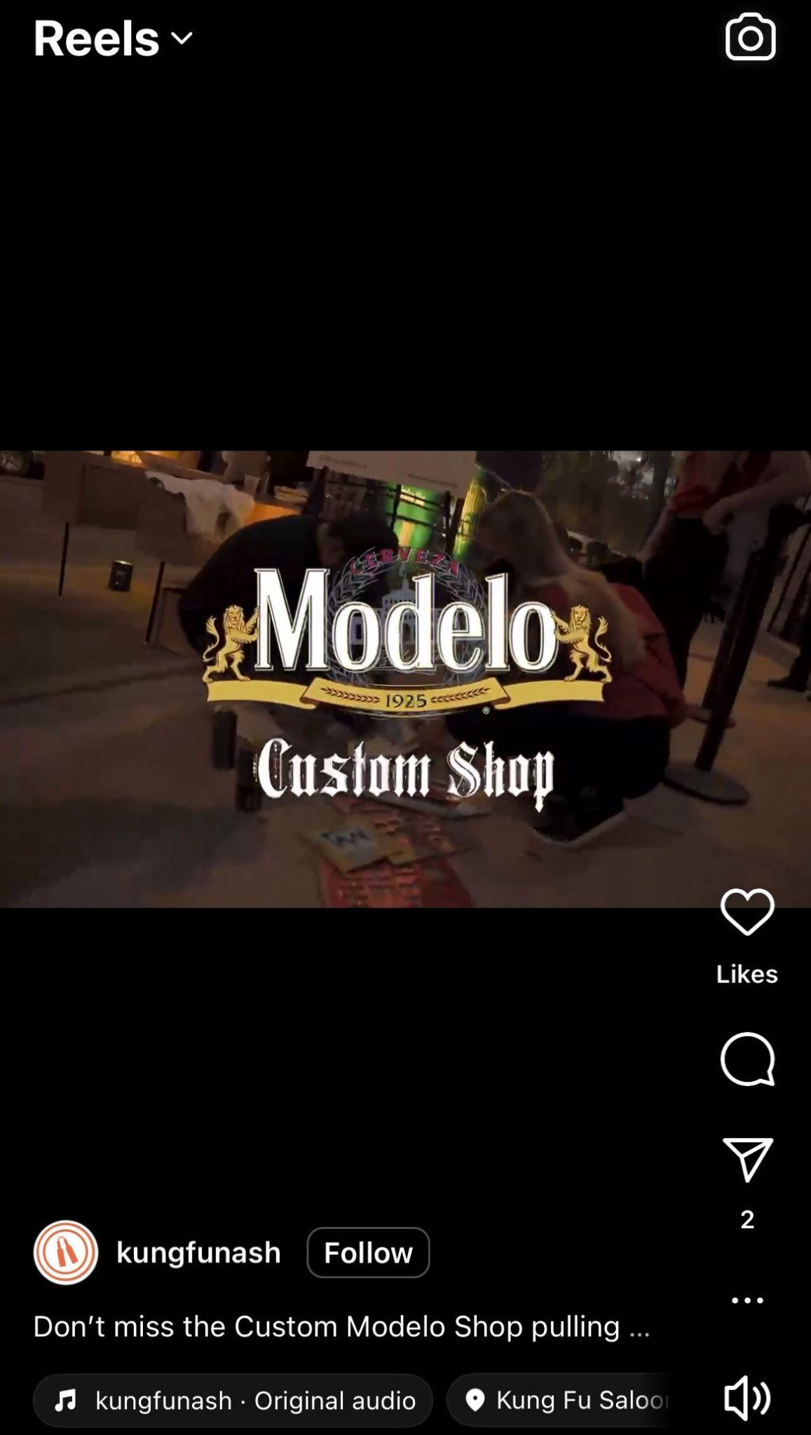
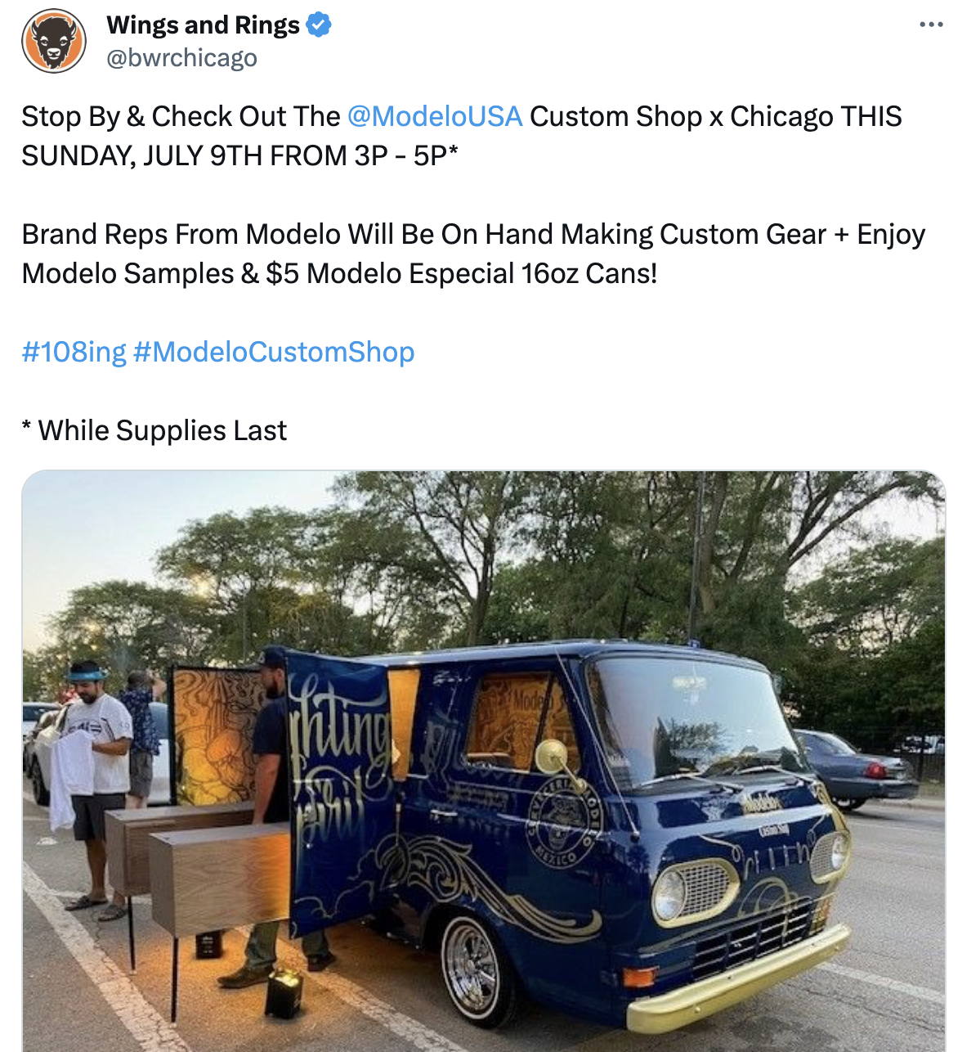
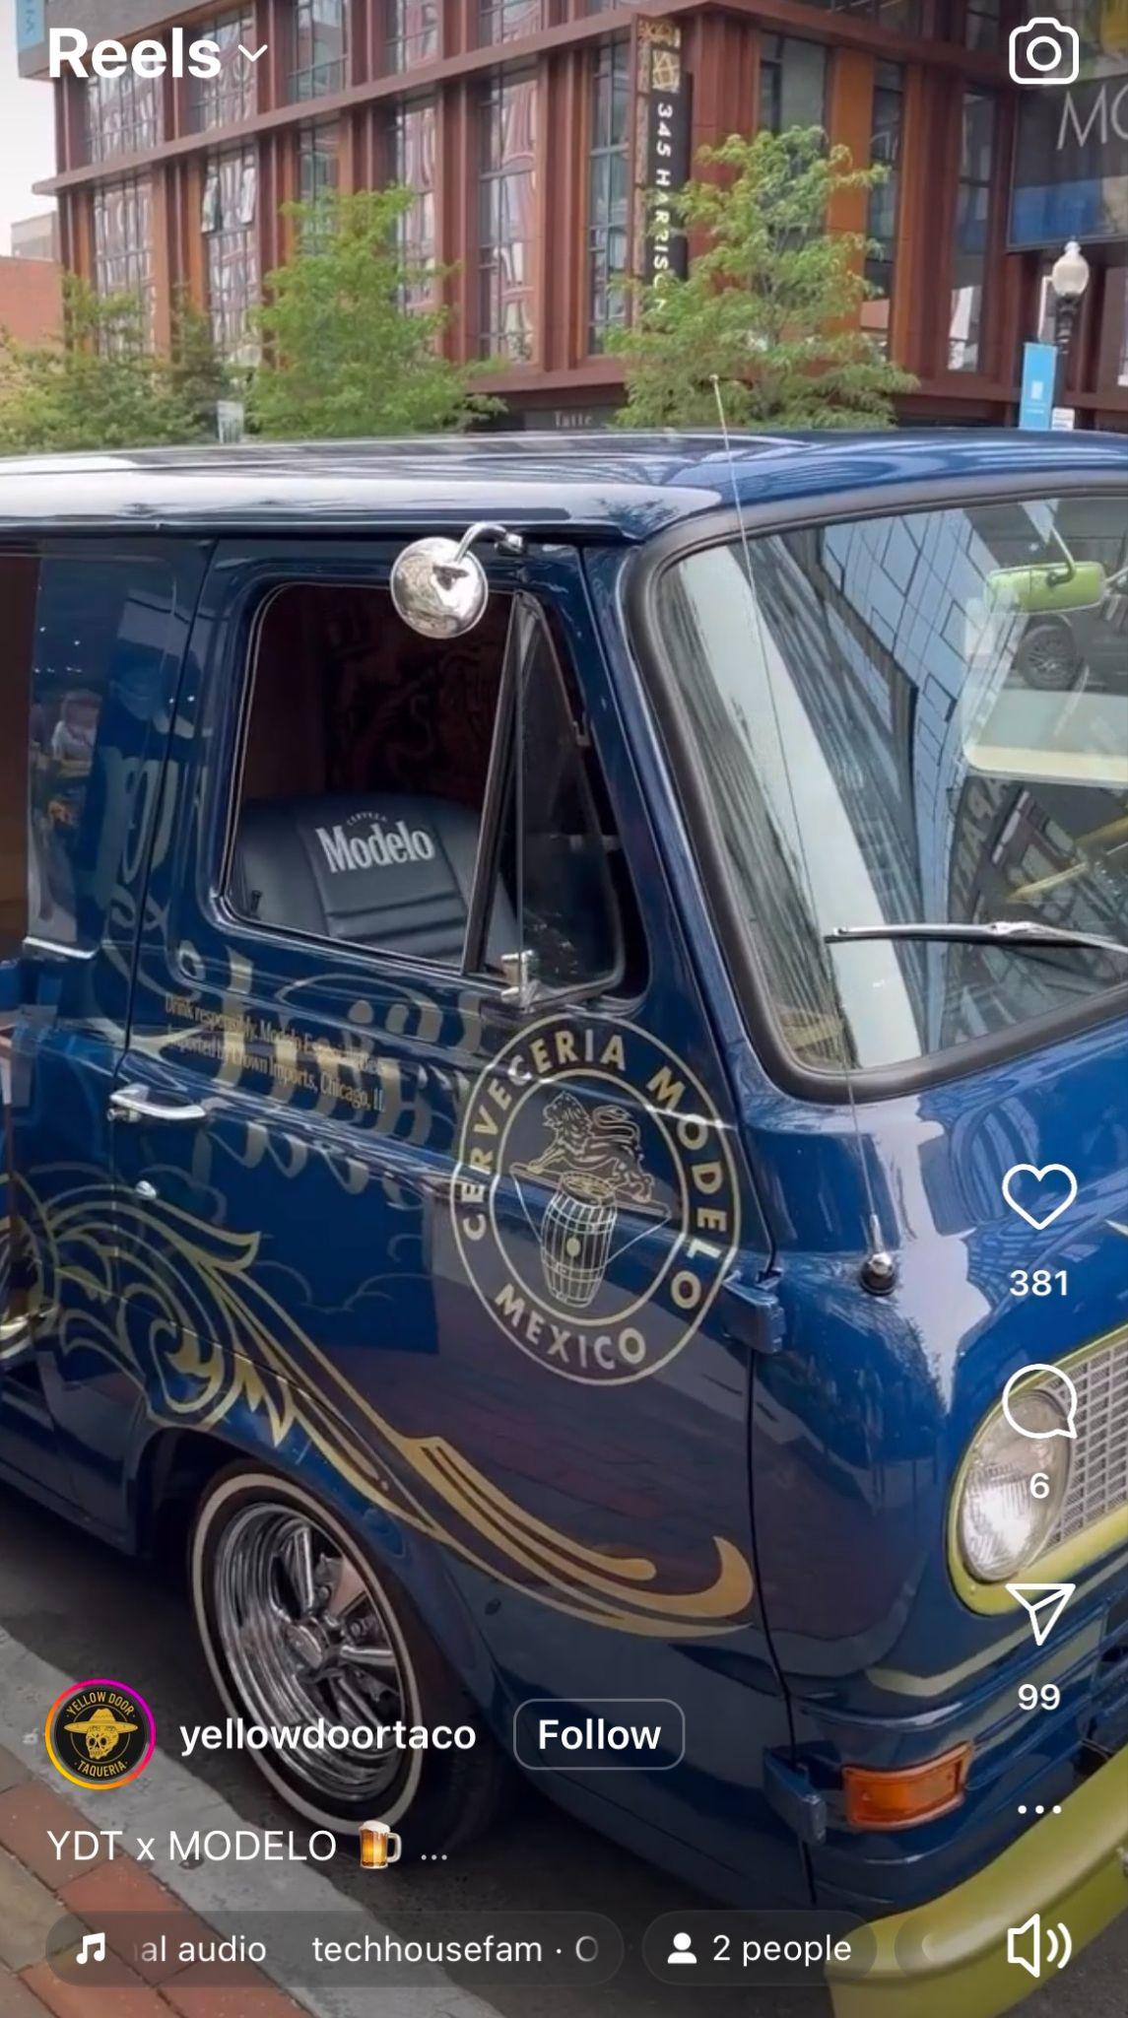
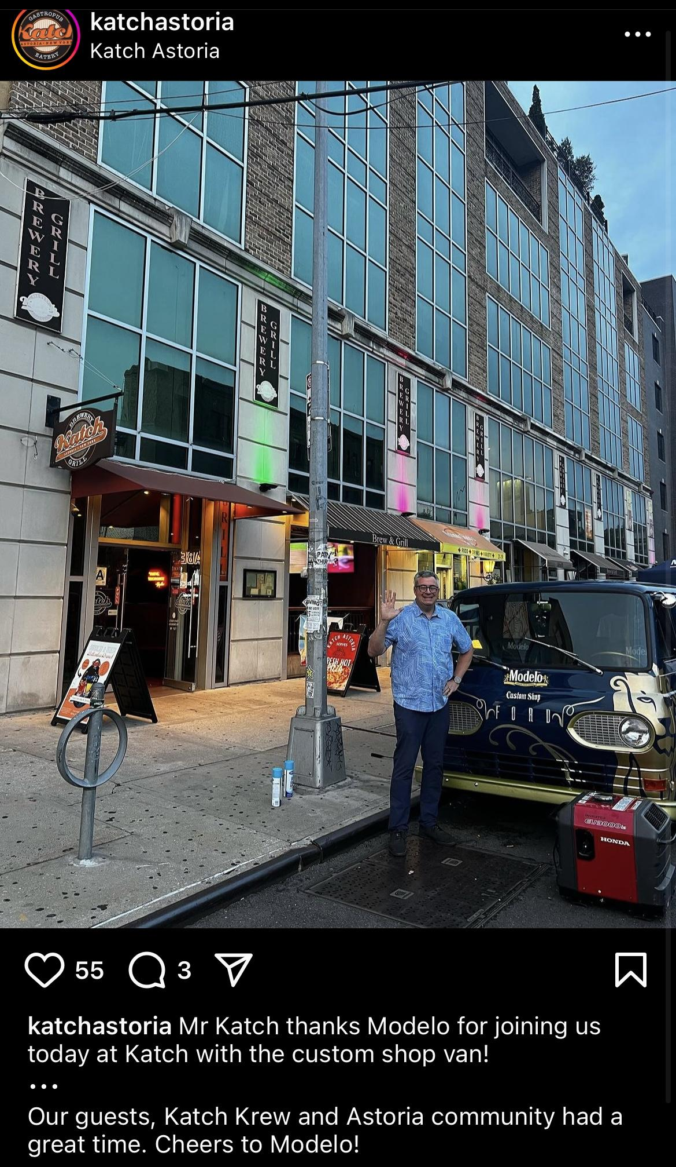
MODELO CUSTOM SHOP EARNED MENTIONS
A majority of earned social mentions were from local businesses hosting the Custom Shop, promoting the event. Some accounts shared formal MCS assets they were initially briefed with while others took artistic liberties, sharing candid, day-of photos.
In 2023, there were 147 total mentions of #ModeloCustomShop.
Source: Social Listening Tool, 2024 Date Range: 5/15/2023-11/15/2023
To adjust the chart style, right-click or control-click on the chart and select “Format Chart Area”

Slide 21
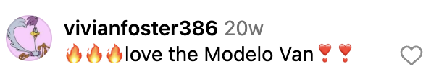
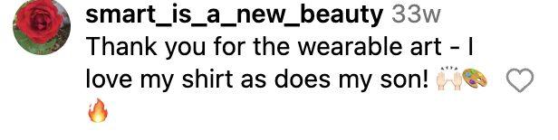
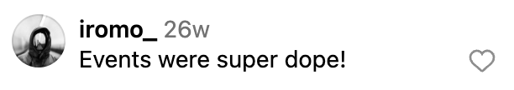
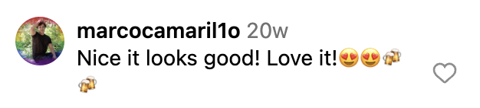
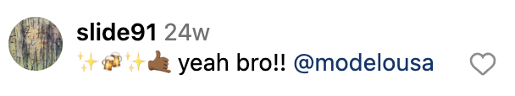
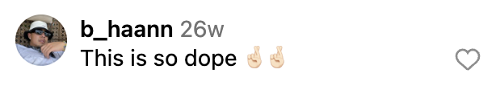
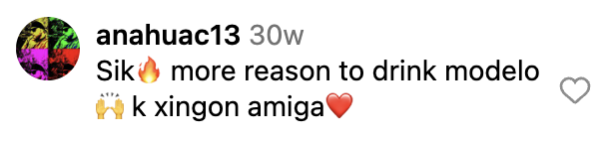
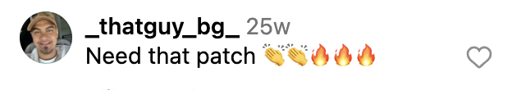
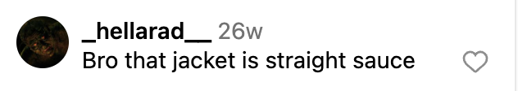
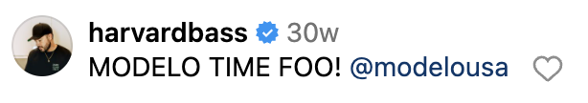
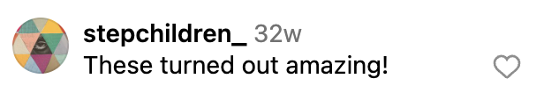
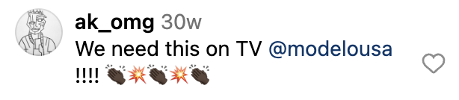
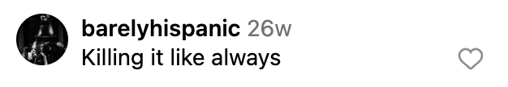
MODELO CUSTOM SHOP COMMUNITY RESPONSE
Sentiment was high across creator and earned Modelo Custom Shop content, with attendees expressing gratitude towards both Modelo and the artists in comments.
Modelo Love
Artist Appreciation
Source: Creator Owned Socials
To adjust the chart style, right-click or control-click on the chart and select “Format Chart Area”

Slide 22
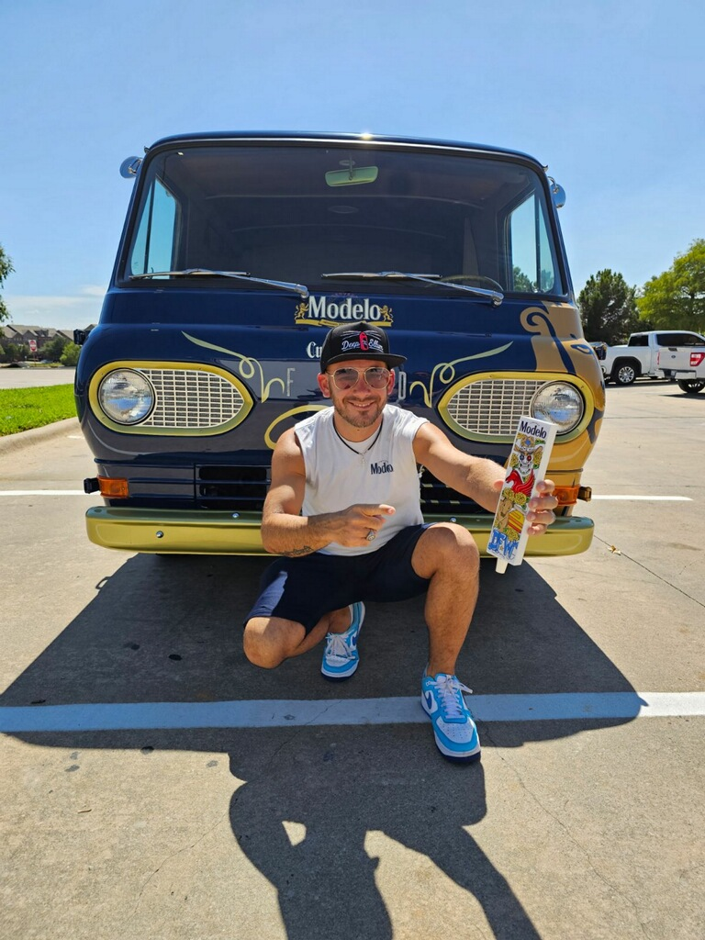
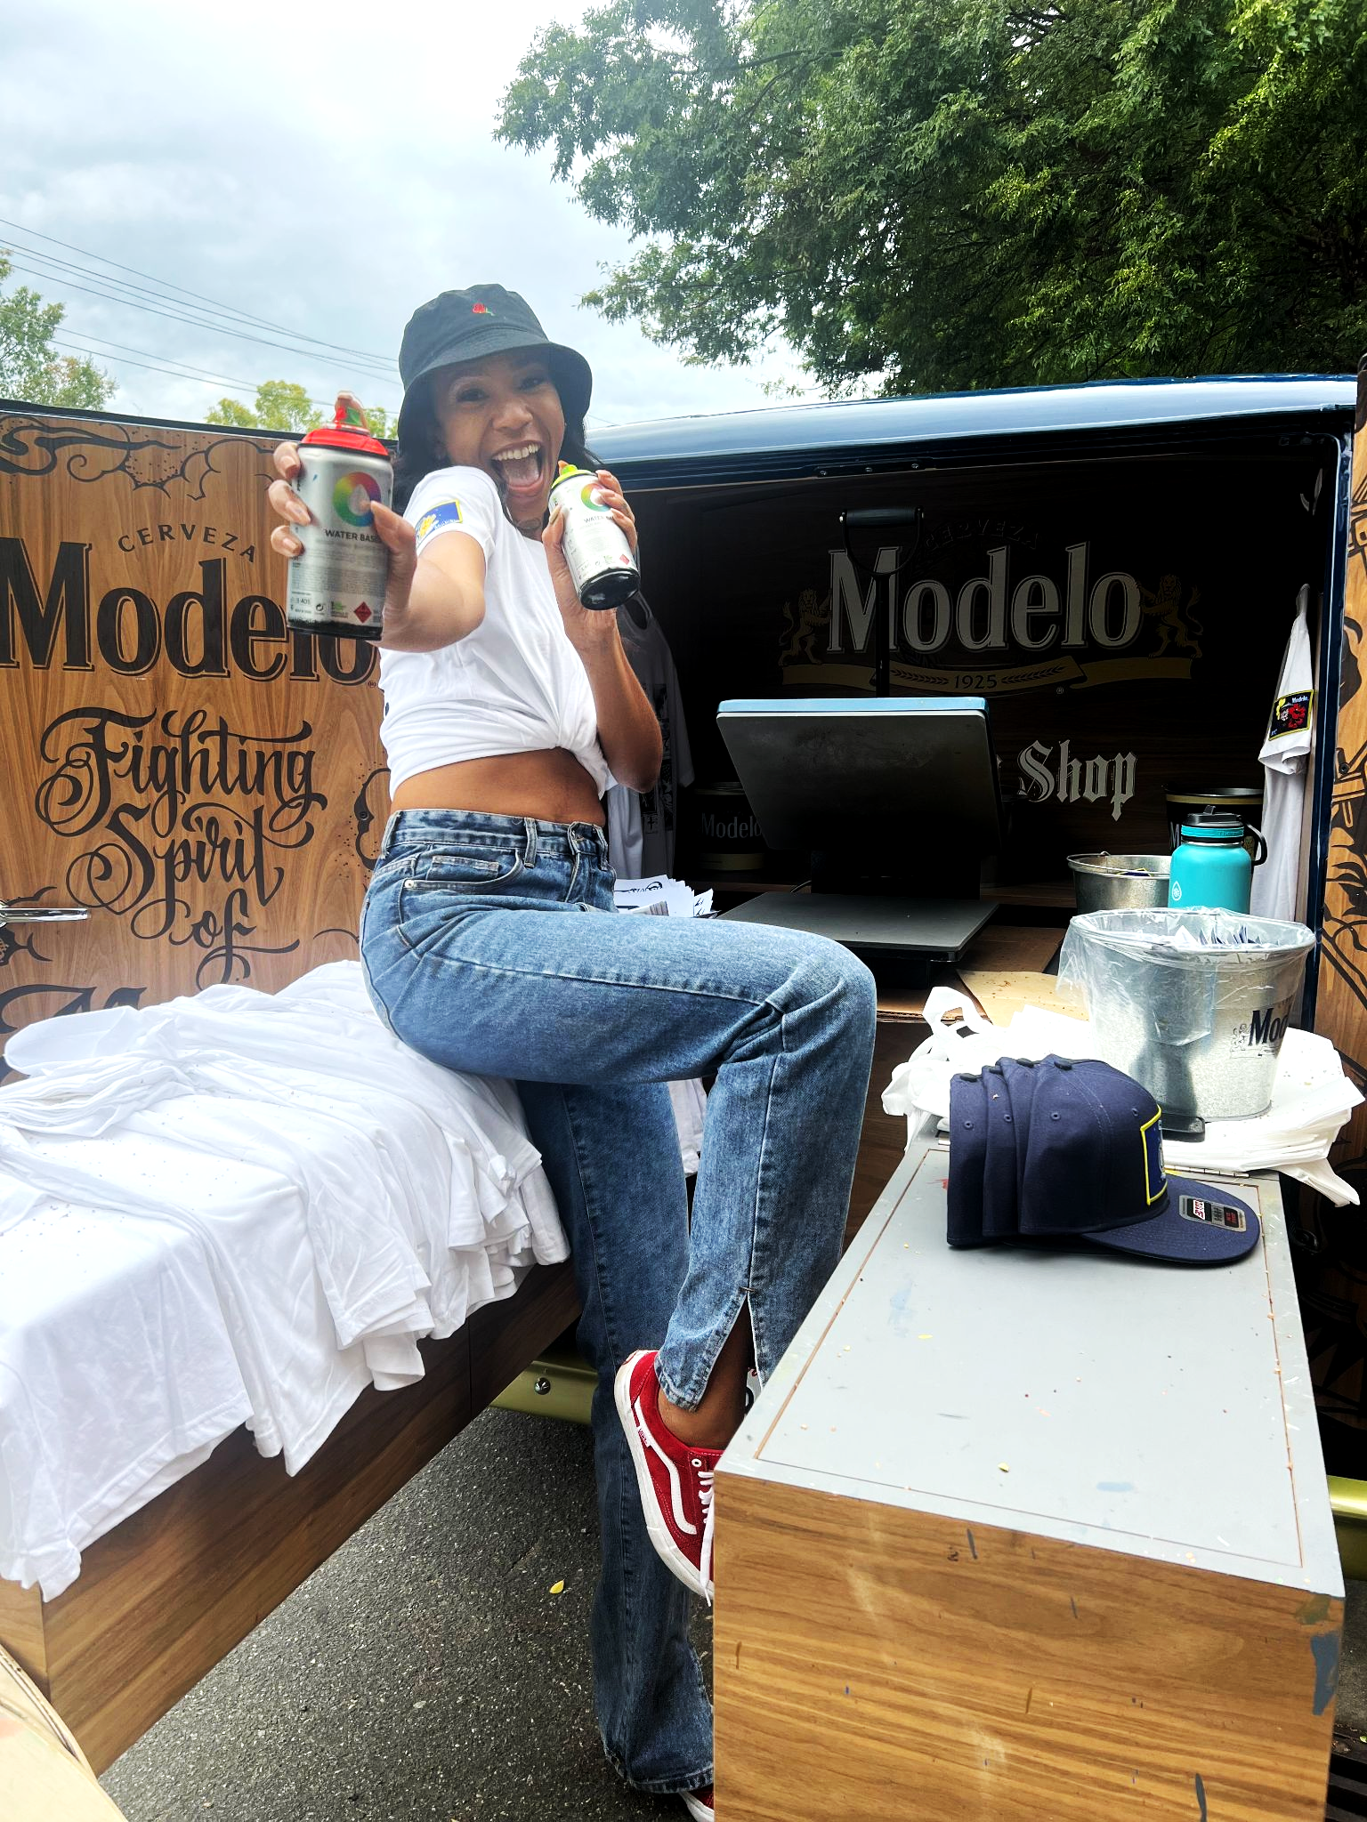
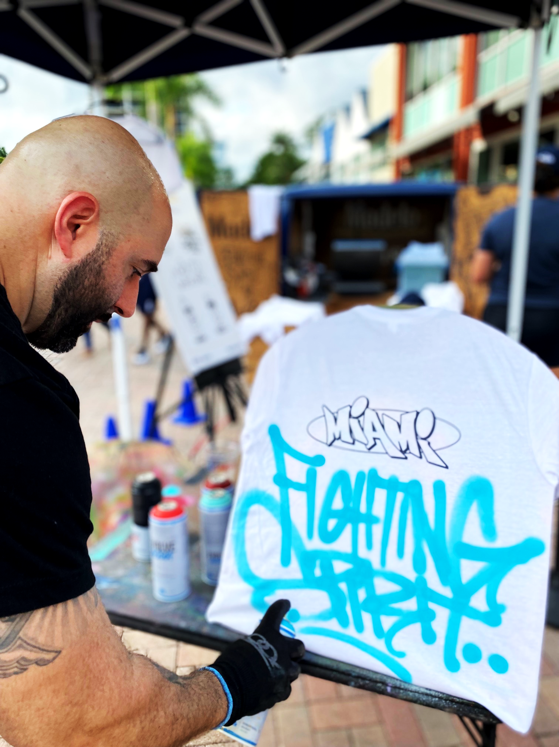
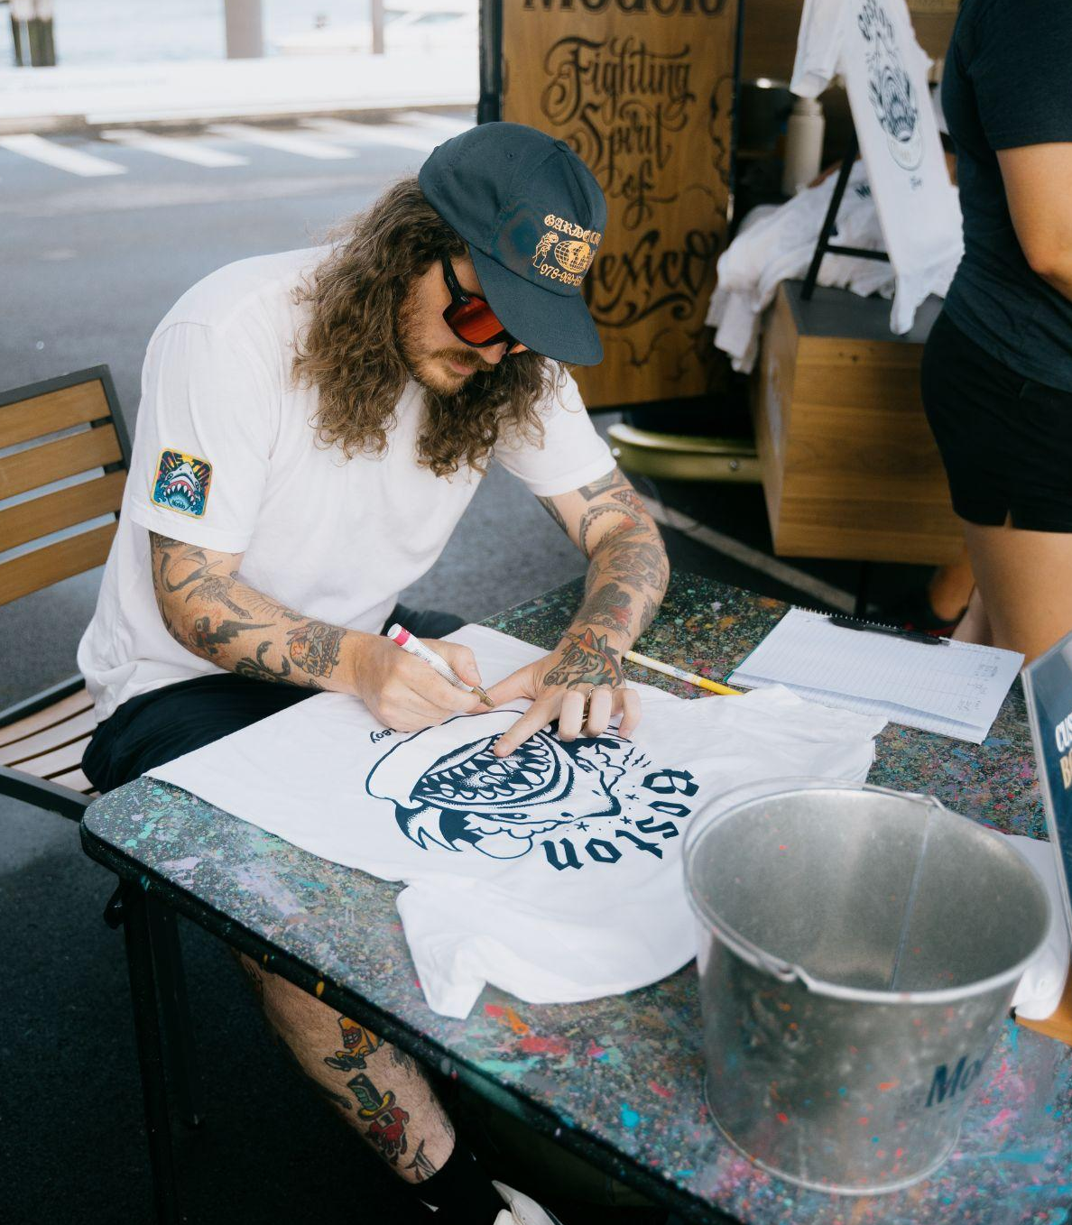
MODELO CUSTOM SHOP
ARTIST PARTNERSHIPS
In Year 3 of Modelo Custom Shop, we partnered with 22 artists across 18 markets and brought back 8 artists from FY23 to create custom Modelo designs which featured their signature identity and the city they represent.
These artist partnerships were integral to fostering a genuine sense of community and contributing to local cultural enrichment.

Slide 23
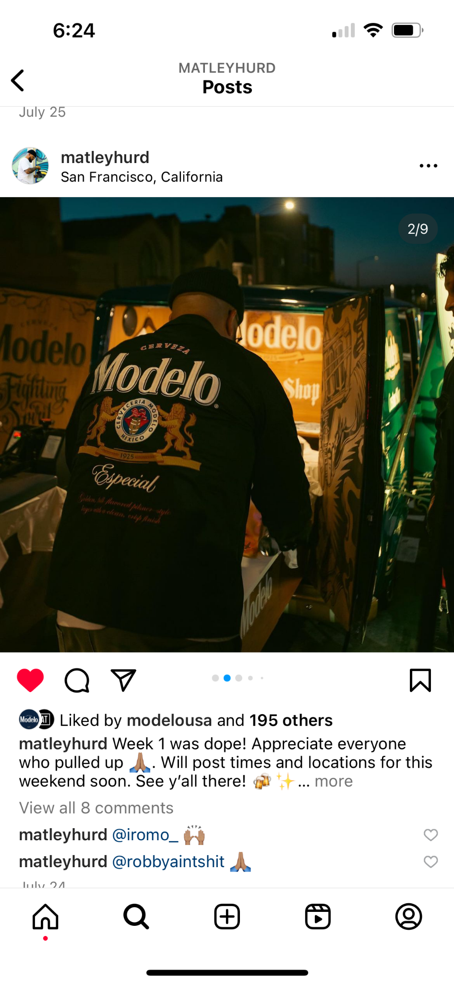
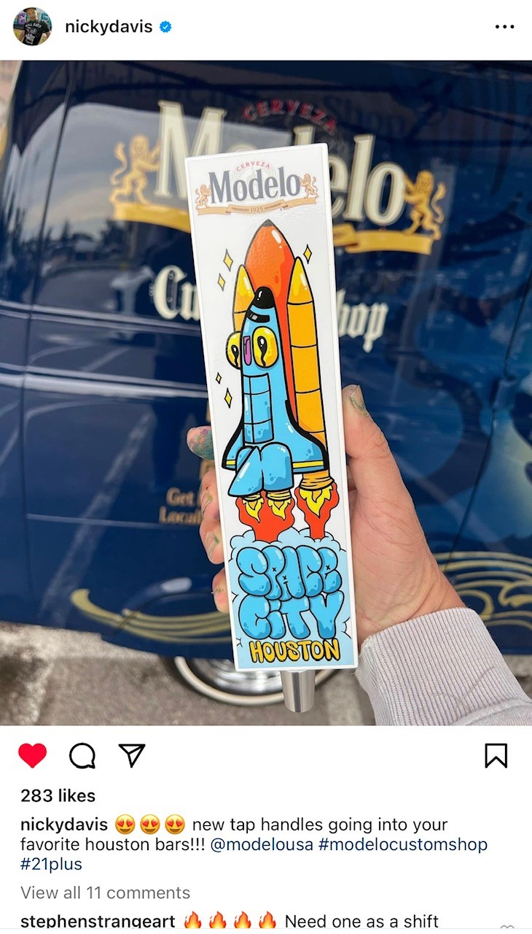


MODELO CUSTOM SHOP ARTIST SOCIAL ENGAGEMENT
Artists across all markets amplified event promotion and buzz via Instagram, sharing over 700 total stories and posts.
The Modelo Custom Shop artists had a combined reach of 771,800 followers.
We saw an uptick in artists creating video teaser and recap posts to promote the program, improving overall engagement.
Artist Social Post Videos:
Matley Hurd Pre-Promotion Teaser: Link Here
Matley Hurd Recap: Link Here
Shawn Perkins Teaser Video: Link Here
Panca Recap Video: Link Here
Account Recap Video: Link Here
To adjust the chart style, right-click or control-click on the chart and select “Format Chart Area”

Slide 24
ARTWORK
© MOMENTUM WORLDWIDE 2023 IN CONFIDENCE. THIS DOCUMENT MAY NOT BE DISTRIBUTED OR COPIED WITHOUT PRIOR CONSENT.

Slide 25











MODELO CUSTOM SHOP
TAP HANDLES

Slide 26














MODELO CUSTOM SHOP
TAP HANDLES

Slide 27










MODELO CUSTOM SHOP
FLASH SHEETS

Slide 28









MODELO CUSTOM SHOP
FLASH SHEETS

Slide 29


















MODELO CUSTOM SHOP
PATCHES

Slide 30




MODELO CUSTOM SHOP
SPORTS ARTIST DESIGNS
Leveraged existing Custom Shop Artists in Charlotte (Dammit Wesley) to produce custom designs for the Charlotte FC Soccer Club and University of North Carolina watch parties to maximize existing partnerships.

Slide 31
PHOTOS & CONSUMER FEEDBACK
© MOMENTUM WORLDWIDE 2023 IN CONFIDENCE. THIS DOCUMENT MAY NOT BE DISTRIBUTED OR COPIED WITHOUT PRIOR CONSENT.

Slide 32



MODELO CUSTOM SHOP
MBN PHOTOS & CONSUMER FEEDBACK
“We’re regulars here and came for this event. There were signs everywhere and so happy we did! This is better than the other beer promotions that come through.”
Cigars & Stripes, Chicago (CBU)
“I’m an artist too, and I think it’s neat how Modelo is using local artists to create these custom designs.”
Charlies, Phoenix (SBU)
“I love this Sugar Skull! It is so unique. No one else is going to have it! I love that.” Garage North, Philly (EBU)
“I just texted all my friends to come check out this event. We love Modelo so they’re going to freak out when they see the van.” Jada Coles, Miami (SEBU)

Slide 33


MODELO CUSTOM SHOP
MBN PHOTOS & CONSUMER FEEDBACK
“Modelo is my brand, and it’s so neat that you can customize these totes, and even label it with Houston.”
Pitch 25, Houston (SBU)
“This is beyond cool, so nice of Modelo to do this for their fans. And these custom T-shirts are amazing. She [Panca] is amazing, going to follow her [IG].”
Culichitown, San Diego (WBU)
“I LOVE my T-Shirt! I can’t wait to drink a Modelo and wear this on my patio this summer.”
Federales, Denver (CBU)
“I love the unique designs we get to choose from. What a different concept for a promo.” Changing Times, New York (EBU)
“I can’t believe what you all are doing is free! I would pay for this t-shirt. Kalin is very talented!” The Union, Charlotte (SEBU)

Slide 34
ACCOUNT FEEDBACK
© MOMENTUM WORLDWIDE 2023 IN CONFIDENCE. THIS DOCUMENT MAY NOT BE DISTRIBUTED OR COPIED WITHOUT PRIOR CONSENT.

Slide 35

MODELO CUSTOM SHOP
ACCOUNT FEEDBACK
“I’ve never seen another brand do this type of event. I love the giveaways. I had to come in today to get a few tote bags customized.
La Diosa, Miami
“Thank you guys so much for this amazing event. We have always supported the brand, but this is beyond what we could have imagined.”
Burgerology, New York
“This is great that you’re doing this for our customers. They’re already wearing the shirts!
Salud Tacos, San Diego
“I love that Modelo is supporting the community by partnering with a local artist.”
Gibson Street Bar, Austin
“This is an amazing event! We posted on social media and people were calling & asking about it. Lots of customers came just for this, so cool.”
JT’s Porch, Chicago

Slide 36

MODELO CUSTOM SHOP
ACCOUNT FEEDBACK
“We love Modelo! We make our Micheladas with it. So happy you’re here!”
Drunken Crab, LA
”This is great, the customers really like the swag. Excited for the VAN to come out!”
Johnny Blacks Public House, Michigan
“It’s so cool that the guy [Matley Hurd] who made this tap handle is here. Happy this bar crawl worked out with the Modelo event”
Jaxson, San Francisco
“This is a great experience for consumers, and we have a good mix of locals and tourists, both who love custom items that say Nashville!.”
Tin Roof Midtown, Nashville
“We loved having you all here last year, and anytime we can support a local artist, along with a great brand, we are here for it!”
Valle Luna, Phoenix
.

Slide 37
KEY LEARNINGS
© MOMENTUM WORLDWIDE 2023 IN CONFIDENCE. THIS DOCUMENT MAY NOT BE DISTRIBUTED OR COPIED WITHOUT PRIOR CONSENT.

Slide 38
MODELO CUSTOM SHOP
MBN KEY LEARNINGS
90/60/30 STATUS CALL IMPORTANCE Adhering to timelines and action items on these calls was crucial to avoid scheduling issues, and ensure we are not making changes to account dates/timing after the 30 day out mark. | CONTINUE W/ RECOMMENDED LOCAL ARTIST Recommend bringing back FY’24 local artists that are familiar with the program intrinsics, and understand program expectations is ideal where applicable, and saves on budget costs. | EXTENDED ACTIVATION RADIUS INCREASES COST Activating outside of the main city extends drive time for BA’s, local artist T&E, and Tour Managers, which increases the overall cost of the program. Keeping accounts within a designated radius will help alleviate this.
PRODUCT AVAILABILITY ISSUES Due to unforeseen draft issues, the team pivoted to ensure secondary types of packaging were available. In the future, being able to offer other brands within the Modelo family might benefit in this instance. | DO NOT ACTIVATE DURING CINCO Activations during Cinco are not recommended due to large crowds. Many accounts were overly crowded, and consumers were intoxicated. Activating before or after Cinco makes for a more impactful activation. | MUST BE ABLE TO ACTIVATE INSIDE Some markets experienced weather related issues or heat advisories. It’s crucial to identify accounts that have enough space to accommodate the activation inside when necessary.

Slide 39
MODELO CUSTOM SHOP
MBN KEY LEARNINGS
BLOCK PRINTING DURING MBN’S Block printing was a great addition to the pre-promo MBN’s, but it took away from the local artist experience during van/artist events. Block printing during the pre-promo events is best suited for this program. | HIGHER QUALITY TAP HANDLE While the art work on the custom tap handle was well received, the flat handle did not look premium, and some accounts were hesitant to display. Creating a 3D tap handle for FY’25 will enticing for accounts, and overall visibility of the brand. | SPANISH POS INCREASED CONSUMER REACH Adding Spanish POS allowed this program to expand it’s consumer reach by providing education and insight on the brand and program details.
HYPER-LOCAL CUSTOMIZATION INCREASES APPEAL Using hyper-local artwork wherever possible connects consumers to the key messaging. Adding in stickers, as well as the local block print this year will help maintain that custom feel that consumers crave. | OPPORTUNITY FOR APPEARANCES The MCS has become a big success for regular program activations, and has the opportunity for growth in other areas like special events, and off-premise appearances. | EVOLVE GIVEAWAYS Increase the large t-shirt sizes and cut back on the smalls. Add hangers for next year’s program for t-shirts and totes to display and for drying time. Numbering the designs on flash sheet will help consumers easily identify the ones they want.

Slide 40
MODELO CUSTOM SHOP SOCIAL LEARNINGS & RECOMMENDATIONS
As we begin to plan for 2024’s Modelo Custom Shop, we’ve identified digital areas of improvement that can help further optimize the program.
Takeaways | Recommendations
Artists had the choice to share an infeed Instagram post or Instagram Story to promote last year’s Modelo Custom Shop. | Stories are a less valuable metric, in terms of awareness, as they expire in 24 hours; for sustained exposure and more quality engagements, require artists to share only infeed posts.
Businesses participating in MCS ‘23 were encouraged to share the event to their socials and contributed to the majority of earned program mentions. | Continue encouraging their social promotion and formalize 2024 briefings, social toolkits and best practices for the program.
No infeed posts were shared from @modelousa’s Instagram account announcing or promoting the 2023’s events. | Cross-promoting the program through official Modelo social channels will help extend overall program awareness and reach.
Creator posts with a mixture of video and static assets performed stronger than those who solely shared static content. | Encourage creators to share a dynamic mix of media to create more engaging post(s).
To adjust the chart style, right-click or control-click on the chart and select “Format Chart Area”

Slide 41
THANK YOU!
© MOMENTUM WORLDWIDE 2023 IN CONFIDENCE. THIS DOCUMENT MAY NOT BE DISTRIBUTED OR COPIED WITHOUT PRIOR CONSENT.

Slide 42
ACCOUNT APPENDIX
© MOMENTUM WORLDWIDE 2023 IN CONFIDENCE. THIS DOCUMENT MAY NOT BE DISTRIBUTED OR COPIED WITHOUT PRIOR CONSENT.

Slide 43
MODELO CUSTOM SHOP
ACCOUNT DETAILS - AUSTIN
ACCOUNT | ADDRESS | EVENTS | IMPRESSIONS | ENGAGEMENTS | SAMPLED | TRADE SPEND
Armadillo Den | 10106 Menchaca Rd | 1 | 95 | 80 | 80 | $474.01
Aussie's | 306 Barton Springs Rd | 1 | 55 | 55 | 55 | $458.90
Bohdi's Hideaway | 10402 Menchaca Rd | 3 | 210 | 200 | 144 | $848.67
Bouldin Acres | 2027 S Lamar Blvd | 3 | 320 | 261 | 162 | $1283.85
Bouldin Acres (Braker) | 1806 W Braker Ln | 1 | 200 | 150 | 111 | $801.29
Bucket's Deli | 2020 E Cesar Chavez St | 1 | 60 | 60 | 60 | $321.20
Deckhand Oyster Bar | 701 W Louis Henna Blvd | 1 | 200 | 125 | 60 | $272.33
Dos Salsas -Domain | 11301 Burnet Rd | 1 | 175 | 125 | 70 | $359.10
Gabriela's South | 9600 S I-35 Frontage Rd | 2 | 180 | 160 | 120 | $774.45
Gibson Street Bar | 1109 S Lamar Blvd | 3 | 295 | 230 | 180 | $1,082.25
Hotel Vegas | 1512 E 6TH ST | 1 | 22 | 22 | 22 | $158.32
Kinda Tropical | 3501 E 7th St | 3 | 300 | 250 | 174 | $1,262.93
La Perla | 1512 E 6th St | 2 | 130 | 130 | 97 | $468.00
Little Woodrow's | 6301 W Pamer Ln | 1 | 150 | 125 | 62 | $380.26
Mala Vida | 708 E 6th St | 1 | 100 | 90 | 60 | $538.65
Moontower Saloon | 10212 Menchaca Rd | 3 | 615 | 395 | 194 | $1,153.05
SABG | 10700 Menchaca Rd | 2 | 325 | 235 | 158 | $433.94
Taquero Mucho | 11101 Burnet Rd | 2 | 215 | 160 | 98 | $631.57
The Park on South Lamar | 4024 S LAMAR BLVD | 1 | 100 | 120 | 70 | $538.65
Yellowjacket Social Club | 1704 E 5TH ST | 3 | 230 | 220 | 180 | $1,278.82
Total |  | 36 | 3,977 | 3,193 | 2,127 | $13,826

Slide 44
MODELO CUSTOM SHOP ACCOUNT DETAILS - DFW
ACCOUNT | ADDRESS | EVENTS | IMPRESSIONS | ENGAGEMENTS | SAMPLES | SPEND
Rusty Nickel | 2836 Stanley Ave | 2 | 160 | 160 | 90 | $662.53
Standard Service | 5631 Alta Ave | 2 | 148 | 148 | 60 | $846.44
Stix Icehouse | 301 Eldorado Pkwy #100 | 1 | 90 | 90 | 66 | $363.83
The Lononder | 5120 State HWY 121 | 1 | 80 | 80 | 60 | $545.58
Rabbit Hole Pub | 3237 White Settlement | 2 | 140 | 140 | 120 | $798.16
Touchdowns | 1409 N Cockrell Hill Rd | 1 | 20 | 20 | 24 | $218.92
Trader’s Village | 2602 Mayfield Rd | 1 | 1,400 | 300 | 160 | $846.95
Trophy Chest | 2225 Connector Dr | 1 | 85 | 85 | 60 | $384.75
Twin Peaks | 1500 Market Pl Blvd | 1 | 200 | 130 | 95 | $669.58
Woody’s | 4744 Bryant Irvin Rd | 1 | 130 | 118 | 60 | $331.24
Yard Dawgs | 217 FM 544 suite 511 | 2 | 157 | 157 | 143 | $724.20
Zona Caliente | 209 E Pleasant Run Rd | 1 | 21 | 21 | 21 | $159.56
Austin Ave. Plano | 935 W Parker Rd. | 2 | 169 | 169 | 140 | $967.77
Barra Libre | 2627 Jefferson Blvd | 2 | 209 | 170 | 120 | $927.11
Federales | 2820 Commerce St | 1 | 125 | 90 | 60 | $461.70
HG Supply | 2008 Greenville Ave | 2 | 80 | 80 | 60 | $461.70
J Gilligan’s | 400 E Abram St | 1 | 500 | 350 | 60 | $448.15
Lava Cantina | 5805 Grandscape Blvd | 1 | 90 | 90 | 70 | $493.76
Longhorn Icehouse | 1901 W Northwest Hwy | 1 | 75 | 75 | 60 | $461.70
Maggies R&R | 1264 W Magnolia Ave | 2 | 135 | 135 | 105 | $458.23
Panther City BBQ | 201 E Hattie St. | 2 | 167 | 137 | 81 | $632.04
Poag Mahones | 700 Carroll St | 2 | 220 | 185 | 120 | $511.00
Rock & Brews | 5351 Nebraska Furniture | 1 | 90 | 90 | 70 | $569.01
Total | 23 | 34 | 3,341 | 3,115 | 2,025 | $13,707

Slide 45
MODELO CUSTOM SHOP ACCOUNT DETAILS -HOUSTON
ACCOUNT | ADDRESS | EVENTS | IMPRESSIONS | ENGAGEMENTS | SAMPLED | TRADE SPEND
Christian's Tailgate | 2820 White Oak Dr. | 1 | 80 | 60 | 60 | $467.63
Cobos | 2012 Rusk St. | 1 | 80 | 45 | 60 | $503.08
Cuchara | 214 Fairview St. Ste 1 | 1 | 200 | 100 | 60 | $461.70
Drift | 1207 W 20th St. | 1 | 75 | 65 | 60 | $310.98
Heights Social | 1213 W 20th St. | 2 | 110 | 90 | 80 | $577.58
Humble Backyard | 7015 Manor Way | 1 | 75 | 70 | 60 | $370.21
Kirby IceHouse | 3333 Eastside St. | 2 | 200 | 140 | 120 | $792.59
Kirby - Memorial | 1015 Gessner Rd. | 2 | 200 | 135 | 120 | $865.80
Kirby - Woodlands | 1700 Lake Robbins Dr | 1 | 150 | 80 | 60 | $425.75
Mayitos | 419 W Little York Rd. #A | 1 | 100 | 60 | 60 | $461.70
Mambo Seafood | 6697 Hillcroft St | 2 | 170 | 150 | 120 | $855.70
Mambo Seafood #5 | 10002 Long Point Rd | 1 | 60 | 55 | 60 | $427.89
Mcintyre’s- The Heights | 1230 W 20th St. | 2 | 200 | 130 | 120 | $1,035.27
Mcintyre’s- Downtown | 901 Commerce St. | 2 | 160 | 130 | 120 | $929.34
Monkey's Tail | 5802 Fulton St. | 1 | 100 | 80 | 60 | $320..62
Moonshine Deck | 1239 W 19th St. | 2 | 190 | 140 | 120 | $929.33
Ojos Locos Memorial | 10516 Katy Frwy | 1 | 110 | 90 | 60 | $435.68
Ojos Locos- Southwest | 9501 Southwest Frwy | 1 | 75 | 65 | 60 | $435.68
Pitch 25 | 2120 Walker St. | 1 | 100 | 75 | 60 | $545.58
Rabbit's got the gun | 708 Hogan St. | 1 | 85 | 75 | 60 | $413.08
Sam's Boat | 5720 Richmond Ave. | 1 | 75 | 60 | 60 | $487.14
Sam's Boat- Cypress | 9955 Barker Cypress Rd. | 1 | 90 | 90 | 70 | $472.83
Sawyer Park Icehouse | 314 Pruitt Rd. | 1 | 100 | 65 | 60 | $467.64
Texas Tailgate | 2401 Texas Ave. | 2 | 140 | 130 | 120 | $1,011.80
Vida Mariscos 249 | 22400 Tomball Pkwy | 1 | 120 | 100 | 70 | $589.87
Wakefield Crowbar | 954 Wakefield Dr. | 1 | 70 | 60 | 60 | $493.66
Total | 26 Accounts | 34 | 4,405 | 3,570 | 2,020 | $15,087.53

Slide 46
MODELO CUSTOM SHOP ACCOUNT DETAILS - NASHVILLE
ACCOUNT | ADDRESS | EVENTS | IMPRESSIONS | ENGAGEMENTS
Assembly Food Hall | 5055 Broadway | 1 | 250 | 130
Big Jimmy's | 109 2nd Ave N | 1 | 165 | 160
Corner Pub Downtown | 5th Ave N | 1 | 160 | 160
Dawg House | 1522 Demonbreun St | 1 | 150 | 95
HiFi Clyde's | 1700 Church St | 1 | 295 | 230
Jonathan's Germantown | 717 3rd Ave N | 1 | 75 | 35
Kung Fu | 1921 Division St | 1 | 300 | 225
Neighbors Franklin | 4031 Aspen Grove Dr | 1 | 75 | 60
Neighbor's Germantown | 313 Jefferson St | 1 | 65 | 45
Red Door (Midtown) | 1816 Division St | 1 | 30 | 25
Rusty Nail | 4054 Andrew Jackson Way | 1 | 35 | 35
Tin Roof (Midtown) | 1516 Demonbreun St | 1 | 100 | 65
Winners/Losers | 1913 Division St. | 1 | 350 | 100
Total | 12 Accounts | 13 | 2,050 | 1,365

Slide 47
MODELO CUSTOM SHOP ACCOUNT DETAILS - PHOENIX
ACCOUNT | ADDRESS | EVENTS | IMPRESSIONS | ENGAGEMENTS | SAMPLED | TRADE SPEND
Barrio Queen- Avondale | 10455 W McDonald | 1 | 250 | 130 | 60 | 502.32
Barrio Queen- Desert Ridge | 21001 N Tatum Blvd | 2 | 165 | 160 | 120 | 877.7
Barrio Queen-Scottsdale | 7114 E Stetson Dr. | 2 | 160 | 160 | 100 | 832.33
Boondocks- Scottsdale | 4341 N 75th St. | 3 | 850 | 475 | 220 | 1870.44
Bourbon Jack's | 11 W Boston St. | 2 | 210 | 190 | 120 | 1189.12
Cham Pang Lanes | 902 N 2nd St. | 1 | 80 | 80 | 60 | 468.96
Charlie's Phoenix | 727 W Camelback Rd. | 2 | 450 | 205 | 126 | 547.2
Cobra Arcade Bar | 801 N 2nd St. | 2 | 210 | 170 | 120 | 871.2
Diego Pops | 4338 N Scottsdale Rd. | 3 | 400 | 305 | 180 | 1008
Dos Gringos Mesa | 1958 S Greenfield Rd. | 1 | 95 | 85 | 60 | 389.88
Goodwood Tavern | 7330 E Stetson Dr. | 3 | 265 | 265 | 180 | 2015.89
Jickey Jack's (JJ's Bar & Grill) | 9611 W Camelback Rd. | 1 | 125 | 100 | 60 | 316.8
Manuel's | 2350 E Southern Ave. | 1 | 100 | 90 | 40 | 194.58
Nando's Mexican Cafe | 7615 E McDowell Rd. | 1 | 95 | 85 | 60 | 468
Phoenix Rising Stadium | 3801 E Washington St. | 1 | 250 | 125 | 0 | 0
Rehab Burger | 7210 E 2nd St. | 1 | 120 | 120 | 60 | 400.32
Salt & Lime | 9397 E Shea Blvd. | 2 | 125 | 125 | 63 | 517.35
The Hot Chick | 4363 N 75th St. | 2 | 350 | 210 | 150 | 925.74
The Hub | 1860 S Stapley Dr. | 1 | 120 | 120 | 60 | 396
The Porch @Arcadia | 4017 E Indian School Rd. | 2 | 380 | 310 | 121 | 1016.4
Valle Luna @Bell Rd. | 3336 W Bell Rd. | 2 | 420 | 195 | 112 | 668.54
Valle Luna @Ray Rd. | 1949 W Ray Rd. | 1 | 200 | 100 | 60 | 280.2
Total | 22 Accounts | 37 | 5,420 | 3,805 | 2,132 | $15,756

Slide 48
MODELO CUSTOM SHOP ACCOUNT DETAILS - SAN ANTONIO
ACCOUNT | ADDRESS | EVENTS | IMPRESSIONS | ENGAGEMENTS | SAMPLES | SPEND
Aquaduck Beer Garden | 9214 ESPADA RD | 1 | 50 | 50 | 27 | $166.41
Bentley’s | 802 N ALAMO | 2 | 320 | 200 | 120 | $909.30
Brooster's Backyard | 815 PLEASANTON RD | 1 | 200 | 125 | 93 | $530.10
Bruno's Dive Bar | 1004 S ALAMO ST | 2 | 235 | 213 | 120 | $962.10
Burleson Yard Beer Garden | 430 AUSTIN ST | 1 | 80 | 70 | 60 | $350.81
Camp 1604 | 5534 N LOOP 1604 W | 1 | 106 | 75 | 66 | $561.26
Dive | 6422 BABCOCK RD STE 100 | 1 | 32 | 32 | 26 | $174.77
El Camino | 1009 Ave B | 1 | 85 | 80 | 72 | $276.99
Elsewhere Garden Bar & Kitchen | 103 E JONES AVE | 1 | 80 | 78 | 60 | $432
Friendly Spot | 943 S AlaSt | 2 | 180 | 163 | 120 | $974.29
La Gloria Mexican Restaurant | 100 E GRAYSON ST | 2 | 340 | 245 | 124 | $834.93
Lucky Duck | 810 N ALAMO ST | 2 | 220 | 185 | 120 | $864
Mcintyre's Southtown | 1035 S PRESA ST | 2 | 380 | 240 | 120 | $935.26
Midnight Swim/Chisme | 2403 N SAINT MARY ST | 2 | 360 | 210 | 166 | $715.64
Pete's Place Spirits & More | 14743 OLD BANDERA RD | 1 | 136 | 95 | 75 | $560.20
Sandbox Bar | 7280 UTSA Blvd Suite 109 | 1 | 60 | 60 | 45 | $241.10
Slackers Sport's Bar- Thousand Oaks | 16620 San Pedro Ave | 1 | 200 | 86 | 36 | $222.12
Smoke | 501 E Crockett St | 1 | 200 | 90 | 60 | $404.74
Southtown 101 | 101 PEREIDA ST.. | 2 | 300 | 232 | 120 | $794.44
Tony’s Siesta | 206 BROOKLYN AVE | 1 | 175 | 100 | 60 | $324.64
Vibras | 3011 N SAINT MARY ST | 2 | 162 | 147 | 96 | $438.53
Grand Total | 21 | 30 | 3.341 | 2,776 | 1,806 | $11,547

Slide 49
MODELO CUSTOM SHOP
ACCOUNT DETAILS - CHICAGO
ACCOUNT | ADDRESS | EVENTS | IMPRESSIONS | ENGAGEMENTS | SAMPLED | BAR SPEND
115 Bourbon St | 3359 W 115Th St, Merrionette Park | 1 | 75 | 75 | 60 | $443.77
Alley 64 | 212 Main St, St. Charles | 1 | 200 | 200 | 60 | $324.00
Anthony'S | 3151 Voyager Ln, Joliet | 1 | 120 | 120 | 66 | $411.60
Austin'S | 481 Peterson Rd, Libertyville | 2 | 200 | 160 | 130 | $1,087.56
Black Door Pub | 255 E Indian Trail Rd, Aurora | 1 | 100 | 90 | 60 | $360.00
Brudder'S | 3600 N Pulaski Rd, Chicago | 1 | 42 | 42 | 42 | $360.00
Buffalo Wings & Rings | 3434 S Halsted St, Chicago | 1 | 125 | 116 | 70 | $379.18
Caminos De Michoacan | 1659 W Cullerton St, Chicago | 1 | 80 | 80 | 70 | $504.00
Chasers (Lake Zurich) | 830 S Rand Rd, Lake Zurich | 2 | 175 | 170 | 120 | $762.00
Cigars & Stripes Bbq Lounge | 6715 Ogden Ave, Berwyn | 1 | 120 | 120 | 60 | $360.00
Crazy Pour | 105 E N Ave, Villa Park | 1 | 75 | 75 | 60 | $394.20
Dam Bar | 65 N River Ln, Geneva | 1 | 100 | 100 | 60 | $384.00
Danny's | 6021 S Archer Ave, Chicago | 1 | 120 | 60 | 60 | $333.97
Demito'S Saloon | 335 E Kenilworth Ave, Villa Park | 2 | 220 | 200 | 120 | $612.00
Diversey Bowl | 2211 W Diversey Pkwy, Chicago | 1 | 160 | 80 | 60 | $437.40
Draft Picks | 523 Fairway Dr, Naperville | 1 | 160 | 120 | 60 | $468.00
Emils Mundelein | 604 N Lake St, Mundelein | 1 | 60 | 60 | 60 | $432.00
Fitz Pub | 172 N Addison Ave, Elmhurst | 1 | 70 | 70 | 60 | $324.00
Greek Prime Kitchen | 901 W 35Th St, Chicago | 1 | 70 | 70 | 60 | $470.70
Guides | 5544 S Archer Ave, Chicago | 1 | 65 | 65 | 60 | $298.07
Harry'S Long Bar | 13115 Western Ave, Blue Island | 1 | 60 | 60 | 60 | $305.40
Jameson'S Pub | 9545 W Saint Francis Rd, Frankfort | 1 | 200 | 100 | 60 | $320.37

Slide 50
MODELO CUSTOM SHOP
ACCOUNT DETAILS - CHICAGO
ACCOUNT | ADDRESS | EVENTS | IMPRESSIONS | ENGAGEMENTS | SAMPLED | BAR SPEND
Jesters | 1500 N Lewis Ave, Waukegan | 2 | 145 | 135 | 120 | $720.00
Jt'S Porch | 665 W Roosevelt Rd, Lombard | 2 | 200 | 160 | 127 | $757.53
JW Hollsteins | 17358 Oak Park Ave, Tinley Park | 1 | 100 | 100 | 60 | $244.17
La Costa Mariscos | N Central Ave, Chicago | 1 | 180 | 180 | 60 | $478.44
Lantern | 8 W Chicago Ave, Naperville | 1 | 150 | 100 | 60 | $396.00
Las Islas | 6560 W Fullerton Ave, Chicago | 2 | 195 | 150 | 120 | $775.01
Martin'S Corner | 2058 W 22Nd Pl, Chicago | 1 | 80 | 80 | 60 | $360.00
Mother Hubbards | 5 W Hubbard St, Chicago | 1 | 65 | 65 | 60 | $420.00
Off The Traxx | 3144 Oak Park Ave, Berwyn | 1 | 65 | 65 | 65 | $429.12
Old Republic | 155 S Randall Rd, Elgin | 3 | 750 | 330 | 180 | $1,348.38
O'Sullivan'S | Madison St, Forest Park | 1 | 70 | 80 | 60 | $509.79
Potter'S Place | 29 W Jefferson Ave, Naperville | 1 | 110 | 90 | 71 | $505.34
Reggie'S | 2105 S State St, Chicago | 1 | 150 | 80 | 60 | $561.96
Rocky'S American Grill | 698 N Milwaukee Ave, Prospect Heights | 1 | 100 | 60 | 60 | $396.40
Sutherlands | 5353 W Irving Park Rd, Chicago | 1 | 100 | 100 | 60 | $378.00
The Cubby Bear | 1059 W Addison St, Chicago | 1 | 30 | 55 | 29 | $299.35
The Green Room Tap | 1802 S Allport St, Chicago | 1 | 80 | 80 | 78 | $456.00
The Whistle Sports Bar | 4911 W 95Th St, Oak Lawn | 1 | 100 | 100 | 60 | $360.00
Third Street Station | 300 Crescent Pl, Geneva | 1 | 160 | 100 | 60 | $426.00
Vintage Lounge | 1447 W Taylor St, Chicago | 1 | 75 | 75 | 60 | $482.76

Slide 51
MODELO CUSTOM SHOP
ACCOUNT DETAILS - DENVER
ACCOUNT | ADDRESS | EVENTS | IMPRESSIONS | ENGAGEMENTS | SAMPLED | TRADE SPEND
American Bonded | 2706 LARIMER ST, Denver | 1 | 50 | 50 | 43 | $347.52
Con Safos | 2715 17TH STREET , Denver | 1 | 20 | 20 | 18 | $164.52
Dark Horse | 2922 BASELINE RD, Boulder | 2 | 170 | 160 | 94 | $889.60
Dive Inn | 1380 S Broadway, Denver | 2 | 195 | 170 | 120 | $881.64
FEDERALES | 2903 Larimer St, Denver | 2 | 400 | 350 | 120 | $933.36
In the Zone | 15600 W 44th Ave, Golden | 2 | 155 | 155 | 78 | $504.00
JD's Bait Shop | 9555 E ARAPAHOE RD, Englewood | 2 | 215 | 140 | 105 | $528.80
Pub on Pearl | 1101 S PEARL, Denver | 1 | 50 | 50 | 45 | $238.00
Recess | 2715 17TH STREET , Denver | 1 | 80 | 100 | 42 | $362.88
ROME’S SALOON | 785 W Mississippi Ave, Denver | 2 | 105 | 105 | 65 | $345.60
Scooters | 13698 E ALAMEDA AVE, Aurora | 1 | 150 | 100 | 60 | $366.00
Stoney's (Uptown) | 1035 E 17th Ave, Denver | 2 | 175 | 135 | 102 | $648.31
STONEYS BAR & GRILL | 1111 Lincoln St, Denver | 2 | 85 | 85 | 75 | $598.47
STONEY’S CANTINA | 30 S Broadway, Denver | 1 | 75 | 75 | 25 | $185.58
Ugly Dog | 1345 CORTEZ ST, Denver | 2 | 120 | 110 | 81 | $576.00
Uno Mas | 730 E 6TH AVE, Denver | 2 | 95 | 95 | 56 | $457.22

Slide 52
MODELO CUSTOM SHOP
ACCOUNT DETAILS - LA
ACCOUNT | ADDRESS | EVENTS | IMPRESSIONS | ENGAGEMENTS | SAMPLED | TRADE SPEND
AUGGIES BAR & GRILL | 5810 IMPERIAL HWY, SOUTH GATE | 2 | 112 | 97 | 83 | $214.80
BREWZ SPORTS | 7921 CANOGA AVE, LOS ANGELES | 1 | 160 | 95 | 88 | $193.16
CASA TORRES | 14117 HUBBARD ST, SYLMAR | 1 | 100 | 70 | 55 | $177.38
DEMPSEYS | 3583 N LOS COYOTES DIAGONAL, LB | 1 | 80 | 70 | 50 | $105.60
DER WOLF | 72 N FAIR OAKS, PASADENA | 1 | 35 | 27 | 26 | $63.50
DRUNKEN CRAB | 13350 SHERMAN WAY, N HOLLYWOOD | 1 | 100 | 80 | 56 | $121.37
EL CAPRICHO RESTAURANT | 827 E. MAIN ST, SANTA PAULA | 1 | 300 | 120 | 90 | $240.00
EL COMPADRE | 1449 SUNSET BLVD, LOS ANGELES | 1 | 95 | 95 | 90 | $382.50
EL MARIACHI RESTAURANT | 15627 VENTURA BLVD, ENCINO | 1 | 60 | 60 | 54 | $153.66
EL PESCADOR (DOWNEY) | 12002 LAKEWOOD BLVD, DOWNEY | 2 | 225 | 190 | 180 | $600.73
EL PESCADOR (EL MONTE) | 11740 VALLEY BLVD, EL MONTE | 1 | 80 | 70 | 60 | $118.80
EL PESCADOR (MONTEBELLO) | 116 E BEVERLY BLVD, MONTEBELLO | 1 | 90 | 80 | 72 | $222.22

Slide 53
MODELO CUSTOM SHOP
ACCOUNT DETAILS - LA
ACCOUNT | ADDRESS | EVENTS | IMPRESSIONS | ENGAGEMENTS | SAMPLED | TRADE SPEND
EL TEJANO | 11122 MAGNOLIA BLVD, LOS ANGELES | 1 | 60 | 60 | 53 | $87.64
FIESTA MARTIN | 300 E. FLORENCE AVE., INGLEWOOD | 2 | 215 | 185 | 135 | $427.68
LA CHUPERIA | 3742 FLOWER ST, LOS ANGELES | 1 | 50 | 40 | 39 | $104.54
LA CITA | 336 S HILL ST, LOS ANGELES | 1 | 75 | 75 | 70 | $317.28
LA COSECHA | 4291 MAINE AVE, BALDWIN PARK | 1 | 90 | 65 | 58 | $120.44
MAX'S | 1101 HUNTINGTON DR., MONROVIA | 1 | 40 | 35 | 35 | $97.90
NICKEL MINE | 11363 SANTA MONICA BLVD, LA | 1 | 56 | 56 | 45 | $181.30
SAGEBRUSH | 23527 CALABASAS RD, CALABASAS | 2 | 195 | 160 | 143 | $537.83
SALSA & BEER | 11669 SHERMAN WAY, N. HOLLYWOOD | 1 | 150 | 100 | 90 | $401.18
TACOS WAY | 1245 SAN FERNANDO RD, SAN FERN | 2 | 141 | 121 | 112 | $297.67
TEXAS LOOSEYS | 22252 PALOS VERDES BLVD., TORRANCE | 2 | 80 | 80 | 75 | $237.00
THE CREST | 1625 CABRILLO AVE, TORRANCE | 1 | 110 | 90 | 42 | $70.20
THE DERBY ROOM | 2201 N WHITE AVE, POMONA | 2 | 600 | 220 | 190 | $515.90
THE PIKE BAR | 1836 E 4TH STREET, LONG BEACH | 2 | 129 | 114 | 99 | $306.91
THE RESIDENT | 428 S HEWITT ST, LOS ANGELES | 1 | 25 | 25 | 19 | $57.60
THE SM WHALER | 101 BROADWAY, SANTA MONICA | 1 | 36 | 36 | 30 | $145.88

Slide 54
MODELO CUSTOM SHOP
ACCOUNT DETAILS - MICHIGAN
ACCOUNT | ADDRESS | EVENTS | IMPRESSIONS | ENGAGEMENTS | SAMPLED | TRADE SPEND
Anchor Bar | 447 Bridge St NW, Grand Rapids | 1 | 90 | 80 | 40 | $48.00
Beach Tiki | 142 E Walled Lake Dr, Walled Lake | 2 | 183 | 138 | 108 | $176.20
CJ Mahoney's | 3260 S Rochester Rd, Rochester Hills | 1 | 67 | 67 | 42 | $68.69
Clarkston Tap | 5801 S Main St, Independence | 1 | 100 | 85 | 73 | $122.40
Detroit Shipping | 474 Peterboro St, Detroit | 1 | 76 | 55 | 38 | $63.98
Donkey | 665 Wealthy ST SE, Grand Rapids | 1 | 103 | 95 | 41 | $72.50
Honest Johns | 488 Selden St, Detroit | 2 | 137 | 137 | 98 | $122.11
Hub Sports | 16780 21 Mile Rd, Macomb | 1 | 70 | 64 | 39 | $45.60
Johnny Blacks Public House | 35000 Moravian Dr., Sterling Heights | 2 | 147 | 133 | 56 | $112.57
Lolo's Bar & Grill | 1862 Ottawa Beach RD, Holland | 1 | 67 | 67 | 22 | $50.35
Old Miami | 3930 Cass Ave, Detroit | 2 | 194 | 170 | 102 | $244.80
Sagebrush | 28 S Broadway, Lake Orion | 2 | 227 | 197 | 123 | $223.80
Steel Cat | 640 Bridge St NW, Grand Rapids | 1 | 79 | 75 | 34 | $62.40
The Score | 5301 Northland DR NE, Grand Rapids | 1 | 105 | 102 | 47 | $66.78
Wick's Park Bar & Grill | 449 Water Street, Saugatuck | 1 | 94 | 90 | 42 | $136.80
Woodridge | 5169 Trumbell, Detroit | 3 | 324 | 239 | 179 | $300.00

Slide 55
MODELO CUSTOM SHOP
ACCOUNT DETAILS - SAN DIEGO
ACCOUNT | ADDRESS | EVENTS | IMPRESSIONS | ENGAGEMENTS | SAMPLED | TRADE SPEND
3in1 Sports Bar & Grill | 2330 Proctor Valley Rd, Chula Vista | 2 | 207 | 187 | 72 | $57.05
Bub's at the Ballpark | 715 J St, San Diego | 2 | 280 | 260 | 195 | $232.78
Cocina Del Charro | 890 W Valley Pkwy, Escondido | 2 | 230 | 210 | 143 | $156.26
Culichitown | 307 Vista Village Dr,Chula Vista | 2.5 | 298 | 263 | 171 | $142.84
El Cruce +241 | 241 3rd Ave, Chula Vista | 2 | 215 | 185 | 114 | $76.07
El Puerto Seafood & Beer | 317 Tenth Ave, San Diego | 1 | 165 | 145 | 65 | $106.21
Fat Joes - Oceanside | 424 S Coast Hwy, Oceanside | 1 | 79 | 79 | 79 | $88.73
La Sabrosita | 2010 Birch Rd, Oceanside | 2 | 241 | 206 | 91 | $76.81
Lahaina Beach House | 710 Oliver Ct, San Diego | 2.5 | 350 | 290 | 180 | $193.68
Mavericks Beach Club | 860 Garnet Ave, San Diego | 2 | 170 | 150 | 65 | $112.84
Papagayos Grill & Cantina | 2220 Otay Lakes Rd, Chula Vista | 2 | 223 | 203 | 95 | $88.78
Salud Tacos | 2196 Logan Ave, San Diego | 2 | 305 | 241 | 141 | $72.65
Smoking Gun | 555 Market St, San Diego | 1 | 120 | 120 | 90 | $166.91

Slide 56
MODELO CUSTOM SHOP
ACCOUNT DETAILS - SAN FRANCISCO
ACCOUNT | ADDRESS | EVENTS | IMPRESSIONS | ENGAGEMENTS | SAMPLED | TRADE SPEND
Bladium Sports Club | 800 W Tower Rd, Alameda | 1 | 50 | 40 | 30 | $169.45
Charlie's Taqueria | 725 B Street, San Mateo | 2 | 110 | 90 | 78 | $153.99
EL GRULLENSE | 2525 El Camino Real, Redwood City | 2 | 105 | 105 | 75 | $197.77
Fernando's Restaurant | 63 37th Ave, San Mateo | 2 | 128 | 120 | 96 | $185.89
Frank Sports Bar & Grill | 2014 Marina Blvd, San Leandro | 2 | 225 | 145 | 118 | $495.60
Jaxson | 3231 Fillmore St, SF | 2 | 230 | 130 | 114 | $309.36
Kirby’s | 42312 Fremont Blvd, Fremont | 2 | 110 | 100 | 70 | $178.80
La Playa | 5460 Cabrillo Hwy, Pacifica | 1 | 125 | 100 | 60 | $77.24
Mexico Tipico | 33121 Alvarado-Niles Rd, Union City | 2 | 125 | 100 | 70 | $302.35
O'Sullivans | 5660 Thornton Ave, Newark | 2 | 185 | 150 | 130 | $502.37
Primo's Pizzeria & Pub | 298 Hartz Ave, Danville | 2 | 200 | 145 | 110 | $373.24
Pupuseria Las Cabanas | 30030 Mission Blvd, Hayward | 1 | 55 | 50 | 42 | $127.58
RETRO JUNKIE | 2112 N Main St, Walnut Creek | 2 | 150 | 100 | 60 | $237.60
San Benito House | 356 Main St., Half Moon Bay | 1 | 220 | 130 | 90 | $326.40
Silver Cloud | 1994 Lombard St, SF | 2 | 160 | 130 | 132 | $344.40
Sunset Cantina | 3414 Judah St, SF | 1 | 70 | 60 | 60 | $135.14
The Ramp | 855 Terry A Francois Blvd, SF | 3 | 440 | 290 | 210 | $625.94

Slide 57
MODELO CUSTOM SHOP
ACCOUNT DETAILS - MIAMI NORTH TERRITORY
ACCOUNT | ADDRESS | EVENTS | IMPRESSIONS | ENGAGEMENTS | SAMPLED | TRADE SPEND
American Social | 721 E Las Olas Blvd, FTL | 2 | 250 | 155 | 120 | $1,028.70
Backyard | 100 SW 3rd Ave, FTL | 2 | 180 | 150 | 120 | $1,051.20
ER Bradley’s | 104 S Clematis St, WPB | 2 | 270 | 175 | 120 | $1,043.00
Fat Cats | 320 Himmarshee St., WPB | 1 | 120 | 100 | 60 | $432.00
O’Shea’s Irish Pub | 531 Clematis St, WPB | 2 | 180 | 145 | 120 | $931.29
Papi Chulo | 1005 N SR7, RPB | 1 | 100 | 90 | 60 | $533.40
Rhythm & Vine | 401 NE 5th Terr, FTL | 1 | 100 | 80 | 60 | $533.40
Roxanne’s | 823 N Federal Highway, FTL | 1 | 90 | 80 | 60 | $609.60
The Boulevard | 1403 W Boynton Beach Blvd, Boynton | 1 | 120 | 70 | 60 | $423.72
The Hive | 2412 Floral Road, Lake Worth | 1 | 150 | 80 | 60 | $326.64
Tijuana Taxi (Davie) | 4400 S University Dr, Davie | 2 | 270 | 145 | 120 | $876.30
Tijuana Taxi (Coral Springs) | 901 N University Dr, Coral Springs | 2 | 250 | 150 | 120 | $914.40
NORTH TOTAL |  | 18 | 1655 | 1320 | 995 | $7,853.64

Slide 58
MODELO CUSTOM SHOP
ACCOUNT DETAILS - MIAMI SOUTH TERRITORY
ACCOUNT | ADDRESS | EVENTS | IMPRESSIONS | ENGAGEMENTS | SAMPLED* | TRADE SPEND
Bar Nancy | 2007 SW 8th Street, Miami | 2 | 160 | 150 | 120 | $914.40
Barracuda Taphouse | 3035 Fuller Street, Coconut Grove | 1 | 35 | 35 | 20 | $170.70
Bougainvillea’s | 7221 SW 58th Avenue, South Miami | 1 | 100 | 80 | 60 | $622.10
Cafe 27 | 4690 US Highway 27, Weston | 2 | 300 | 190 | 120 | $481.30
Chela’s Cocteleria | 15301 NW 67th Avenue, Miami Lakes | 2 | 150 | 130 | 110 | $809.76
Jada Coles | 2845 Coral Way, Miami | 2 | 180 | 155 | 120 | $1,152.00
La Diosa | 7321 Miami Lakes Drive, Miami Lakes | 1 | 100 | 80 | 60 | $525.00
Monty’s Raw Bar | 2550 S Bayshore Drive, Coconut Grove | 1 | 150 | 80 | 60 | $431.20
Tacos & Tattoos | 11790 SW 104th Street, Miami | 1 | 100 | 80 | 60 | $388.80
Tap Beer | 17850 W Dixie Hwy, North Miami | 1 | 60 | 50 | 40 | $297.20
The Bar | 172 Giralda Avenue, Coral Gables | 1 | 100 | 80 | 60 | $457.60
The Corner | 1035 N Miami Ave, Miami | 2 | 140 | 140 | 101 | $720.98
The Dirty Rabbit | 151 NW 24th Street, Miami | 1 | 80 | 70 | 60 | $481.50
SOUTH TOTAL |  | 18 | 2080 | 1420 | 1080 | $8,803.65

Slide 59
MODELO CUSTOM SHOP
ACCOUNT DETAILS - DC/NOVA
ACCOUNT | ADDRESS | EVENTS | IMPRESSIONS | ENGAGEMENTS | SAMPLED* | TRADE SPEND
Banditos Tacos & Tequila | 10621 Braddock Rd, Fairfax VA | 3 | 385 | 310 | 206 | $292.45
Clarendon Ballroom | 3185 Wilson Blvd, Arlington VA | 4 | 340 | 310 | 260 | $468.39
Don Tito | 3165 Wilson Blvd, Arlington VA | 3 | 540 | 417 | 270 | $316.12
El Rey | 4201 Wilson Blvd, Arlington VA | 4 | 480 | 405 | 276 | $478.00
Quinn’s On The Corner | 1776 Wilson Blvd, Arlington VA | 2 | 410 | 285 | 150 | $236.80
Spider Kelly’s | 3181 Wilson Blvd, Arlington VA | 6 | 930 | 690 | 505 | $754.72
The Revolution Darts & Billiards | 9687 Fairfax Blvd, Fairfax VA | 2 | 305 | 230 | 180 | $240.00
Baja Tap | 2436 18th Street NW, DC | 2 | 275 | 210 | 130 | $1,425.60
Cafe Saint-Ex | 1847 14th Street, DC | 3 | 550 | 320 | 180 | $1,821.60
Don Juan Restaurant | 1660 Lamont Street NW, DC | 1 | 75 | 65 | 60 | $354.76
Madhatter | 1319 Connecticut Ave, DC | 3 | 480 | 330 | 149 | $1,305.60
Mi Vida (The Wharf) | 98 District Square, DC | 2 | 400 | 195 | 120 | $1,108.80
Mi Vida (14th Street) | 1901 14th Street NW, DC | 2 | 250 | 175 | 110 | $1,069.20
Public Bar Live | 1214 18th Street, DC | 3 | 400 | 275 | 180 | $1,231.20
Howard Theater | 620 T Street, DC | 2 | 210 | 180 | 220 | $1,593.00
TOTAL |  | 42 | 6,030 | 4,397 | 2,996 | $12,696.24
*NoVA: 4oz samples
*DC: 12oz samples

Slide 60
MODELO CUSTOM SHOP
ACCOUNT DETAILS - CHARLOTTE
ACCOUNT | ADDRESS | EVENTS | IMPRESSIONS | ENGAGEMENTS | SAMPLED | TRADE SPEND
Big Ben Pub | 1535 Elizabeth Ave, Charlotte | 2 | 235 | 185 | 75 | $544.36
Boatyard | 8418 Statesville Rd, Cornelius | 2 | 320 | 200 | 120 | $1,083.50
Bradshaw’s Social House | 8440 Rea Rd, Charlotte | 2 | 170 | 140 | 90 | $634.84
Carolina Premium Bev. | 4435 Beam Rd, Charlotte | 1 | 150 | 120 | 0 | $0.00
Clutch | 601 S Cedar St, Charlotte | 2 | 260 | 210 | 86 | $428.37
Ed’s Tavern | 2200 Park Rd, Charlotte | 2 | 180 | 150 | 95 | $493.76
Flying Saucer | 9605 N Tryon St A, Charlotte | 2 | 160 | 140 | 93 | $725.40
Freemore Tavern | 1500 W Morehead St, Charlotte | 2 | 180 | 155 | 104 | $632.06
Gin Mill | 1423 S Tryon St, Charlotte | 2 | 200 | 170 | 95 | $741.00
Grace O’Malley’s | 157 N Trade St, Matthews | 2 | 140 | 120 | 90 | $700.10
Kilted Buffalo | 1212 Central Ave, Charlotte | 1 | 150 | 120 | 60 | $461.70
La Victoria | 16139 Lancaster Hwy, Charlotte | 2 | 220 | 185 | 120 | $737.88
Moo & Brew | 1300 Central Ave, Charlotte | 2 | 175 | 145 | 120 | $770.99
Moochie’s Tavern | 15060 Idlewild Rd, Matthews | 2 | 150 | 140 | 100 | $520.70
Port City Club | 18665 Harborside Dr, Cornelius | 2 | 250 | 200 | 100 | $1,026.00
Rally | 101 Southside Dr, Charlotte | 2 | 195 | 165 | 120 | $761.81
Sammy’s | 25 S Main St, Belmont | 2 | 175 | 150 | 120 | $742.50
State of Confusion | 3500 Dewitt Ln, Charlotte | 2 | 150 | 125 | 100 | $659.26
The Union | 222 E Bland St #200, Charlotte | 2 | 150 | 130 | 100 | $554.44

Slide 61
MODELO CUSTOM SHOP
ACCOUNT DETAILS - PHILLY
ACCOUNT | ADDRESS | EVENTS | IMPRESSIONS | ENGAGEMENTS | SAMPLED | BAR SPEND
Condesa | 1830 Ludlow St | 2 | 340 | 255 | 120 | $1,146.35
Deke’s BBQ | 137 W Berkley St | 2 | 160 | 160 | 100 | $336.50
Flanigan’s Boathouse | 113 Fayette St | 2 | 160 | 160 | 96 | $502.56
Garage North | 100 E Girard Ave | 2 | 165 | 135 | 110 | $903.44
Great American Pub | 123 Fayette St. | 2 | 140 | 135 | 110 | $576.00
Independence Beer Garden | 100 S INDEPENDENCE MALL W | 2 | 300 | 195 | 120 | $918.72
Los Cabalitos Cantina | 1653 E Passyunk Avenue | 2 | 100 | 100 | 120 | $817.38
Maggie’s Waterfront | 9242 N Delaware Ave | 3 | 225 | 215 | 180 | $1,350.00
Manayunk Brewery | 4120 Main St | 2 | 130 | 130 | 110 | $936.00
New Deck Tavern | 3408 Sansom St. | 1 | 50 | 50 | 36 | $260.70
Saloon 151 | 151 W Gay St. | 1 | 55 | 55 | 45 | $318.00
Taqueria Amor | 4410 Main St | 2 | 213 | 208 | 120 | $897.00
The Fainting Goat | 105 S Macdade Blvd. | 2 | 155 | 150 | 113 | $864.00
Time Out Tavern | 4024 West Skippack Pike | 1 | 28 | 28 | 24 | $144.00
Uptown Beer Garden | 1500 John F Kennedy Blvd | 2 | 185 | 165 | 120 | $1,005.28
Urban Saloon | 2120 Fairmount Ave | 2 | 230 | 200 | 120 | $950.40
TOTALS |  | 30 | 2,636 | 2,341 | 1,644 | $11,926.33

Slide 62
MODELO CUSTOM SHOP
ACCOUNT DETAILS - BOSTON
ACCOUNT | ADDRESS | EVENTS | IMPRESSIONS | ENGAGEMENTS | SAMPLED | TRADE SPEND
Beantown Pub | 100 Tremont St | 2 | 200 | 180 | 155 | $556.80
Bodega Canal | 57 Canal St | 2 | 185 | 180 | 180 | $719.04
Dillon's | 955 Boylston St | 2 | 350 | 200 | 180 | $579.12
El Potro Mexican Grill | 170 Everett Ave | 2 | 200 | 150 | 140 | $341.87
Granary Tavern | 170 Milk St | 1 | 250 | 200 | 90 | $328.70
Loco Taqueria - Fenway | 61 Brookline Ave | 2 | 400 | 250 | 180 | $635.94
Naco Taco | 297 Massachusetts Ave | 2 | 180 | 180 | 145 | $393.31
Pier 6 | 1 8th St | 3 | 350 | 220 | 255 | $739.40
Tall Ship | 1 E Pier Dr | 2 | 400 | 200 | 180 | $400.50
THE LANDING | 60 Long Wharf | 2 | 300 | 200 | 180 | $448.80
Yellow Door - Mission Hill | 1619 Tremont St | 2 | 250 | 200 | 180 | $477.64
Yellow Door | 354 Harrison Ave | 2 | 200 | 190 | 180 | $518.16
TOTALS |  | 24 | 3265 | 2350 | 2045 | $6,139.28

Slide 63
MODELO CUSTOM SHOP
ACCOUNT DETAILS - NY
ACCOUNTS | ADDRESS | EVENTS | IMPRESSIONS | ENGAGEMENTS | SAMPLED | BAR SPEND
3308 EATS & DRINKS | 33 08 Broadway | 1 | 100 | 80 | 60 | $463.92
Agua E Coco | 3132 E Tremont Ave | 1 | 100 | 80 | 60 | $552.20
Amor Loco | 131 W 46th Street | 1 | 80 | 80 | 60 | $627.12
Barley Beach House | 95 Dearborn Ave | 1 | 75 | 70 | 60 | $504.00
Barley on the Hudson | 236 Green St | 1 | 65 | 60 | 60 | $576.00
Beach Pub | 102 Washington DR | 1 | 25 | 25 | 25 | $360.00
Belfast | 101 N Wellwood Ave | 1 | 100 | 80 | 60 | $625.40
Bohemian Hall | 2919 24TH AVE | 1 | 125 | 80 | 60 | $560.61
Break Bar | 3204 Broadway | 1 | 175 | 85 | 60 | $360.00
Broadway Station Bar | 3009 Broadway | 1 | 80 | 70 | 60 | $587.93
Brooklyn Crab | 24 Reed St | 1 | 100 | 75 | 60 | $402.40
Buena Onda | 1446 1St Ave | 1 | 140 | 120 | 120 | $1,245.72
Burgerology | 11 Railroad Ave | 1 | 150 | 150 | 60 | $646.36
Burkes Bar | 645 Bronx River Rd | 1 | 80 | 70 | 70 | $504.00
Calaveras Corner | 936 Amsterdam Avenue | 2 | 200 | 120 | 120 | $1,097.72
Canz | 1610 Old Country Road | 1 | 100 | 80 | 60 | $672.98
Canz | 4780 Sunrise HWY | 1 | 75 | 75 | 60 | $378.38
Changing Times Farmingdale | 1247 Melville RD | 1 | 75 | 70 | 60 | $617.40
Chanos Cantina | 3555 31st ST | 1 | 30 | 30 | 30 | $237.86
Clara's | 53 Wilson Ave | 1 | 40 | 40 | 36 | $308.95
Cobblestones Pub | 11718 Queens BLVD | 1 | 140 | 80 | 60 | $627.12
Cue Bar | 4518 Bell BLVD | 1 | 100 | 85 | 60 | $402.09

Slide 64
MODELO CUSTOM SHOP
ACCOUNT DETAILS - NY
ACCOUNTS | ADDRESS | EVENTS | IMPRESSIONS | ENGAGEMENTS | SAMPLED | BAR SPEND
Del Fuego | 117 DEER PARK AVE | 2 | 200 | 200 | 60 | $564.01
Don Pancho Villa | 189 Borinquen Pl | 1 | 100 | 100 | 60 | $541.26
Don Tequila | 8338 Woodhaven BLVD | 1 | 75 | 75 | 60 | $401.03
Dos Marias | 200 New Main St | 1 | 60 | 60 | 60 | $470.34
Finleys of Greene Street | 43 Green St | 1 | 100 | 65 | 60 | $547.48
Francey Bradys | 72 Main Street | 2 | 125 | 120 | 120 | $1,203.12
Gallo | 3 E Main St | 1 | 70 | 70 | 60 | $587.82
Hanger 11 | 11911 Metropolitan Ave | 1 | 60 | 60 | 60 | $618.60
Havana Social - Stone Street | 45 Stone Street | 2 | 240 | 120 | 120 | $1,194.68
Hibiscus Bar | 12418 101st Ave | 1 | 30 | 30 | 30 | $491.24
Horses and Divorces | 285 Bedford Ave | 1 | 60 | 60 | 40 | $287.01
Hot Jalapeno | 219 E 116th ST | 1 | 80 | 60 | 60 | $538.95
Hurricane Grill & Wings | 496 County Road 111 STE 2 | 1 | 80 | 60 | 60 | $538.95
il Sole | 233 Dykman St | 1 | 50 | 50 | 50 | $482.89
Katch Astoria | 3119 Newtown Ave | 1 | 75 | 60 | 60 | $599.21
Kent Ale House | 51 Kent Ave | 2 | 175 | 160 | 120 | $1,031.00
La Cantinita | 2715 Hempstead TPKE | 1 | 190 | 60 | 60 | $1,114.54
La Perla | 65 E Main St | 1 | 90 | 90 | 60 | $733.88
Lazy Boy Saloon | 154 Mamaroneck Ave | 2 | 70 | 70 | 60 | $470.34
Lucharitos | 834 Walt Whitman Rd. Ste B | 2 | 215 | 215 | 120 | $1,090.74
Lucy's Cantina | 1 Pennslyvania Plaza | 1 | 80 | 60 | 60 | $634.28
Mad Dog & Beans | 83 Pearl Street | 1 | 75 | 75 | 60 | $439.90

Slide 65
MODELO CUSTOM SHOP
ACCOUNT DETAILS - NY
ACCOUNTS | ADDRESS | EVENTS | IMPRESSIONS | ENGAGEMENTS | SAMPLED | BAR SPEND
Maggie Spillanes | 571 Gramatan Ave | 2 | 160 | 145 | 120 | $1,188.48
Mamajuana | 247 Dykman St | 1 | 200 | 60 | 60 | $463.95
Mamasuhi | 3478 E Tremont Ave | 1 | 80 | 70 | 60 | $541.28
McMahon's | 39 5th Ave | 1 | 150 | 80 | 60 | $520.80
Meetball Place | 54 W Main St | 1 | 150 | 150 | 60 | $370.80
Mesa Azteca | 91 Wykoff Ave | 1 | 75 | 60 | 60 | $391.94
MG 54 Bar | 1548 1546 UniversityAve | 1 | 50 | 60 | 60 | $462.95
Minnesotas | 959 W Beech St | 1 | 40 | 40 | 39 | $451.19
Minnesotas | 76 W Main St | 1 | 100 | 100 | 60 | $576.00
Mission taco | 371 New York Ave | 1 | 100 | 100 | 60 | $569.36
Ocean's 8 Billiards | 308 Flatbush Ave | 1 | 250 | 200 | 60 | $403.20
One Station Plaza | 21310 41ST AVE | 1 | 80 | 80 | 60 | $733.73
ONeil's | 6421 53rd DR | 1 | 100 | 100 | 60 | $476.93
Pig Beach | 35 37 36th ST | 1 | 150 | 80 | 60 | $386.63
Puerto Plata | 42 Woodcleft Ave | 1 | 75 | 75 | 60 | $708.19
Queens Beer Factory | 8613 Northern BLVD | 1 | 60 | 60 | 60 | $447.74
Rambling House | 4292 Katohna AVE | 1 | 70 | 60 | 60 | $600.00
Rancho Grande | 1789 Central Park Ave | 1 | 75 | 60 | 60 | $244.10
Ray's Bar | 177 Chrystie Street | 2 | 205 | 160 | 120 | $1,142.40
RC Dugans | 2316 Hempstead TPKE | 1 | 70 | 60 | 60 | $600.00
Republic Latin Fusion | 181 N 10th St | 1 | 60 | 60 | 45 | $474.75
Rockwells | 60 Terry RD | 1 | 100 | 100 | 60 | $432.00

Slide 66
MODELO CUSTOM SHOP
ACCOUNT DETAILS - NY
ACCOUNTS | ADDRESS | EVENTS | IMPRESSIONS | ENGAGEMENTS | SAMPLED | BAR SPEND
Roebling Sporting Club | 225 N 8th St | 1 | 60 | 60 | 60 | $397.13
Rudis Bar & Grill | 554 Medford Ave | 1 | 200 | 150 | 60 | $446.90
Rust & Gold | 345 Main ST | 1 | 150 | 120 | 60 | $391.04
Salty Dog | 7509 3rd Ave | 1 | 80 | 70 | 60 | $589.85
Salud | 1413 Bushwick Ave | 1 | 30 | 30 | 30 | $274.37
Saxon Woods Grill | 315 Mamaroneck Rd | 1 | 200 | 120 | 60 | $504.00
Seafood City | 459 City Island Ave | 1 | 150 | 85 | 60 | $432.00
Sean Ogs | 6002 Woodside Ave | 1 | 80 | 80 | 60 | $450.00
Stephens Green | 12 Fisher Ave | 2 | 141 | 120 | 120 | $846.00
Sucker Punch | 344 3rd Avenue | 2 | 400 | 280 | 120 | $1,153.77
Superfine | 126 Front St | 2 | 140 | 140 | 120 | $1,152.00
Sweet Spot | 2272 31st St | 1 | 100 | 100 | 60 | $576.17
Tacovision | 244 E 53rd Street | 1 | 60 | 60 | 60 | $541.26
Tailgate Brooklyn | 86 N 11th St | 2 | 200 | 150 | 120 | $1,175.89
TaqueRio Taco Bar | 1 Van Der Donck St | 2 | 130 | 130 | 120 | $1,160.14
That Bar | 47 5th Ave | 1 | 70 | 70 | 60 | $558.08
The Bench Bar & Grill | 1095 N Country RD | 1 | 70 | 70 | 60 | $508.36
The Corner | 270 Main St | 1 | 70 | 60 | 60 | $600.00
The Gaf | 1696 2nd Avenue | 2 | 120 | 120 | 120 | $1,245.72
The Gaf West | 401 W 48th Street | 1 | 70 | 60 | 60 | $600.00
The Kettle Black | 8622 3rd Ave | 1 | 70 | 70 | 60 | $553.88
The Mean Fiddler | 266 W 47th Street | 1 | 70 | 60 | 60 | $600.00

Slide 67
MODELO CUSTOM SHOP
ACCOUNT DETAILS - NY
ACCOUNTS | ADDRESS | EVENTS | IMPRESSIONS | ENGAGEMENTS | SAMPLED | BAR SPEND
The Red Hot Grill | 1701 2nd Ave | 1 | 60 | 60 | 60 | $644.40
The Waylon | 736 10th Avenue | 1 | 70 | 60 | 60 | $579.94
The Wild Goose Pub | 5420 Roosevelt Ave | 1 | 70 | 70 | 60 | $524.11
Tiesto's Restaurant | 411 W Main St | 1 | 70 | 70 | 60 | $600.00
Tito Murphy's | 346 W 46th Street | 2 | 160 | 120 | 120 | $1,245.72
Tommys | 109 Main St | 1 | 75 | 75 | 60 | $432.00
Toro Loco | 15 Stone Street | 1 | 70 | 65 | 60 | $618.60
Tropix Bar & Grill | 9532 Queens BLVD | 1 | 80 | 80 | 60 | $427.28
Vistamar | 565 City Island Ave | 1 | 65 | 65 | 60 | $532.88
Viva Toro | 987 Grand St | 1 | 100 | 90 | 60 | $481.23
Walters Bar | 389 8th Avenue | 1 | 80 | 70 | 60 | $524.30
Walters Cottage | 500 W 43rd St | 1 | 80 | 70 | 60 | $570.64
Wash. Irving Boat Club | 238 Green St | 1 | 150 | 100 | 60 | $287.84
Yankee Tavern | 72 E 161st St | 1 | 75 | 70 | 60 | $519.12
Years | 8609 Northern BLVD | 1 | 60 | 60 | 60 | $317.39
TOTALS |  | 120 | 10781 | 8915 | 6875 | $62,187.90

